Slide 1
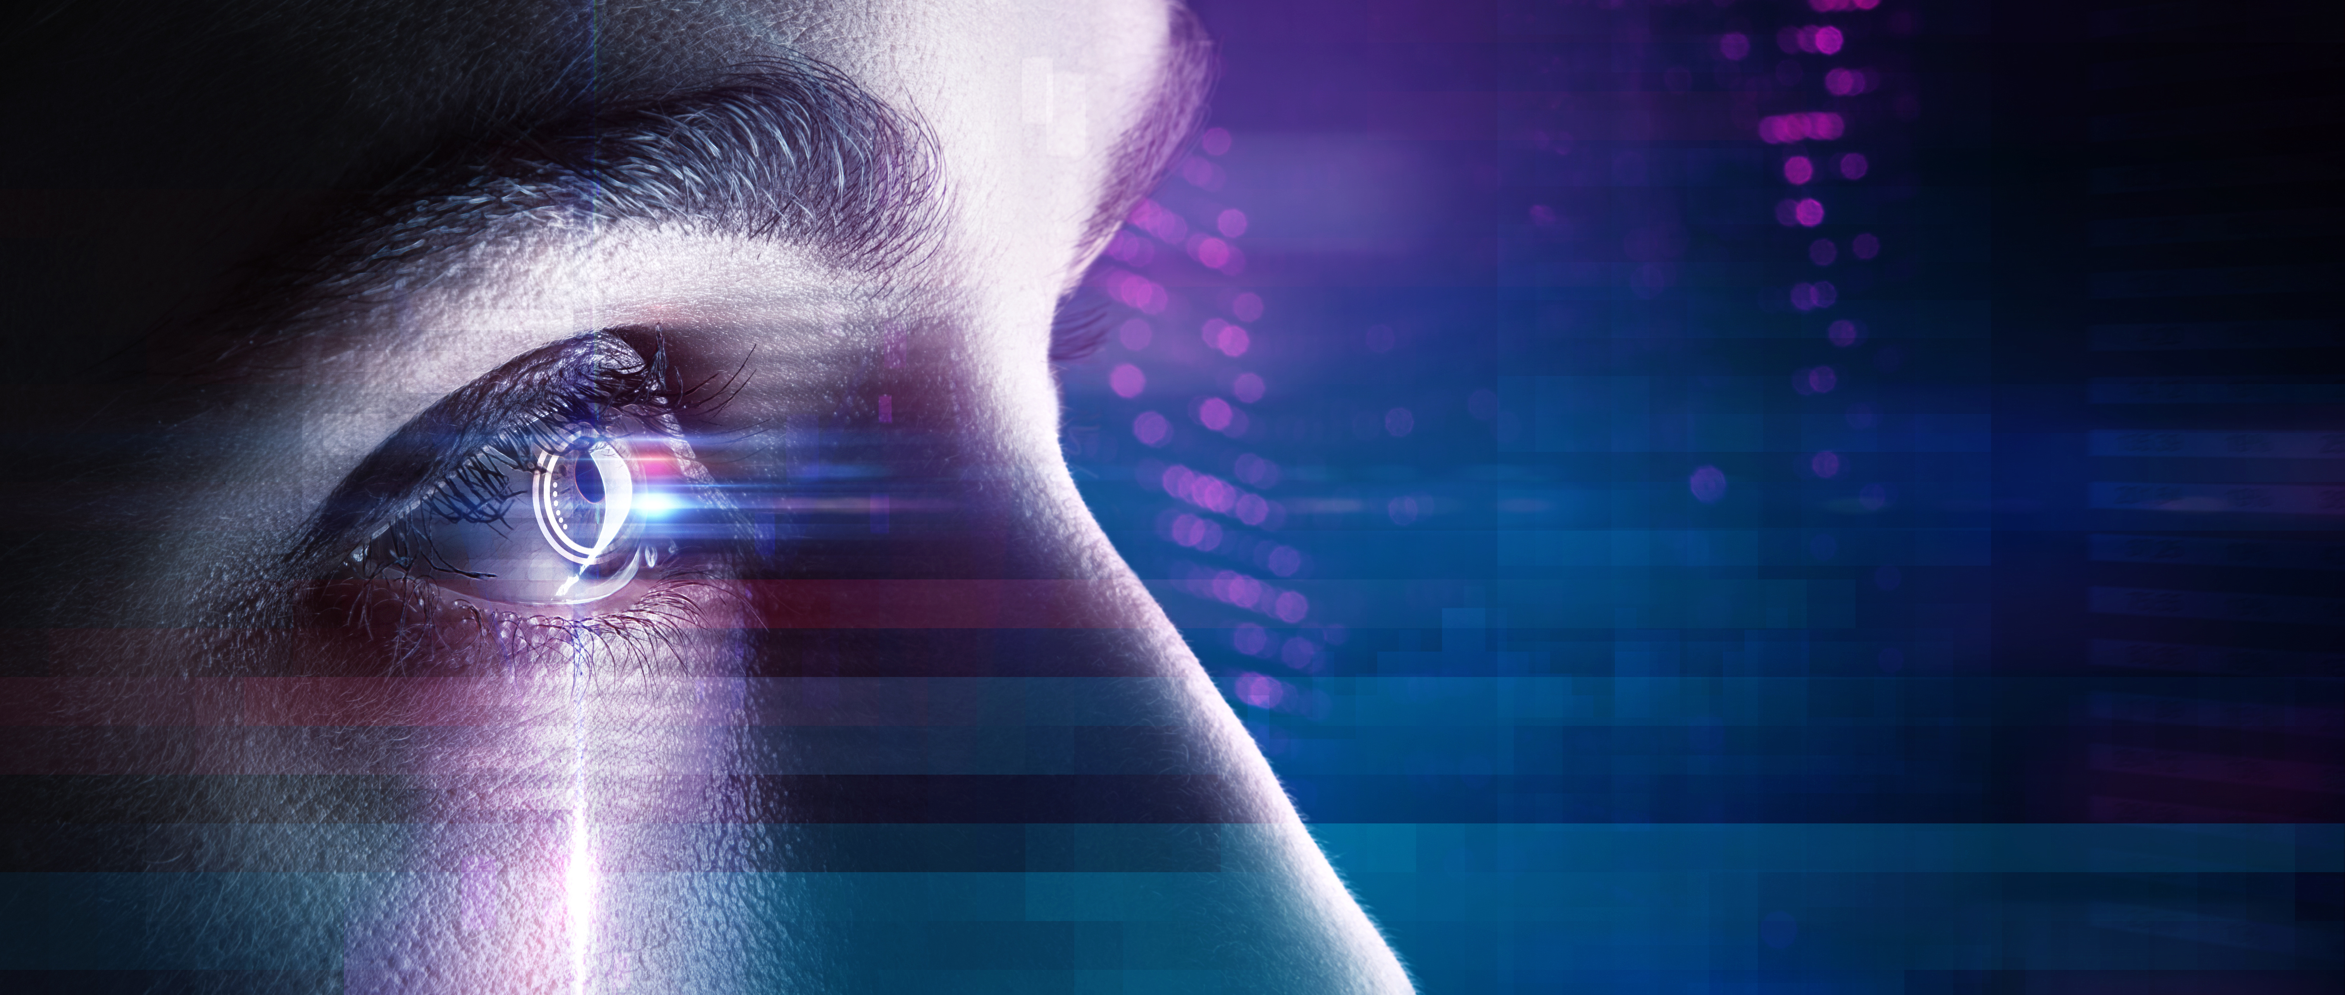
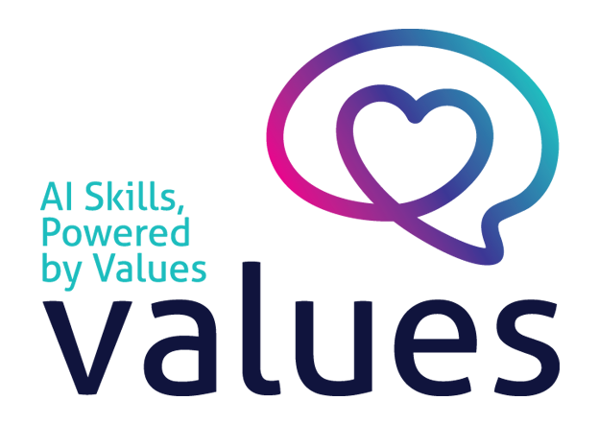

www.valuesai.eu
MODULE 07
Acting Legally with AI
Rights, Consent and Responsible Use
Co-funded by the European Union. Views and opinions expressed are however those of the author or authors only and do not necessarily reflect those of the European Union or the Foundation for the Development of the Education System. Neither the European Union nor the entity providing the grant can be held responsible for them.

Slide 2
Contents
01
Why acting legally with AI matters (10 min) 3
02
Voice rights and AI (10 min) 9
03
Image and likeness rights (10 min) 14
04
Copyright in the AI era (10 min) 19
05
AI law: EU AI Act and GDPR (10 min) 23

Slide 3
01
Why acting legally with AI matters
(10 min)

Slide 4
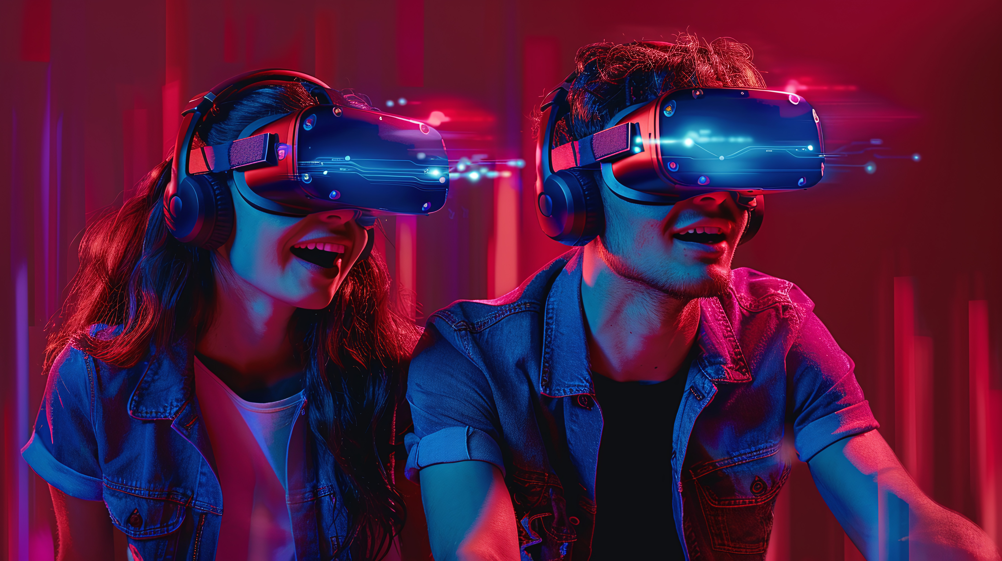
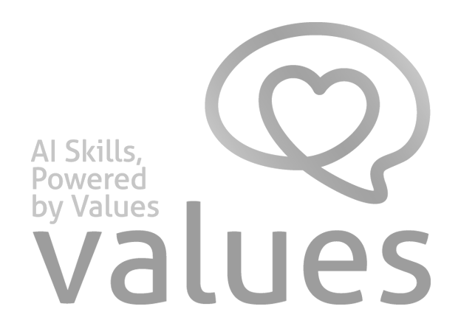
AI tools make it easy - in seconds - to clone voices, generate faces, copy styles, and reuse text. Just because something is possible does not mean it is lawful.

Slide 5
Why this matters:
Legal violations can lead to fines, lawsuits, takedowns, and reputational damage.
Liability often falls on the person who uses or publishes the output - not on the AI tool.
Lawful use is also a form of respect: for people, creators, and institutions.
”Legal” is more than copyright - it covers personality rights, data protection, and AI-specific rules.
Example: Asking AI to summarise a public news article is generally fine. Asking AI to clone a colleague's voice for a prank - without their consent - is not

Slide 6
AI use creates three legal risks: personality, copyright, and regulation
When you use AI, three legal layers can be triggered at the same time:
Personality rights risk: Using someone's voice, face, or name without consent - even in fiction or satire - can violate their image / publicity rights.
Copyright risk: AI inputs and outputs may copy protected works. Generated images can resemble existing artworks; generated text can reproduce passages.
Regulatory risk: GDPR, the EU AI Act, sector laws (health, finance, education), and contracts may impose duties - especially around disclosure and personal data.

Slide 7
Ask: Whose rights does this touch? Could a court agree?
Use checks: Voice Gate + Image Checklist + Copyright Check
Assume AI outputs are legally clean
Use AI to imitate real people without permission
DO
DON’T

Slide 8
For Legal Use
Use four questions whenever you use AI in a way that could touch the law
Lawfulness
Rights
Transparency
Accountability
Do I have a clear legal basis (consent,
licence, exception)?
Whose rights does my use touch - voice,
face, name, IP?
Can I tell readers
/ users when
AI was involved?
Could I defend
my choice
if challenged?
Lawful AI use = informed choices guided by values

Slide 9
02
Voice rights and AI
(10 min)

Slide 10
Your voice is data - and personal
AI can clone a voice from a few seconds of audio.
That changes what :voice” means in law:
A voice identifies a person → under GDPR, voice can be personal data, and voiceprints can be biometric data
A voice has commercial value - actors, narrators, singers, and public figures rely on it
“Sounds like” is enough to harm someone (reputation, fraud, deception)
Performers rights protect existing recordings - even short samples used to train a voice model can be problematic

Slide 11
Key Takeaway: Voice rights and the law
Cloning, modifying, or imitating a real voice
can trigger several legal regimes at once:
Personality / publicity rights: many countries protect a person's voice as part of their identity. Commercial use without consent is usually unlawful.
GDPR (EU): voice processing usually requires a legal basis. Voiceprints are special-category data and need stronger justification.
Performers' rights: actors and singers have rights over their recorded performances; using them to train AI may need separate clearance.
Defamation and fraud: voice clones used to impersonate or deceive can lead to civil and criminal liability.
EU AI Act: AI-generated audio that imitates a real person (voice deepfake) must generally be labelled.

Slide 12
Voice Consent Gate
(3 Questions):
Decide before you clone
Use this gate whenever your AI use involves a real person's voice (clone, impression, modification):
Permission:
Identifiability:
Disclosure:
Do I have written consent
(or a clear licence) for this voice and this purpose?
Could the result be confused with the real person?
Could it harm or mislead?
Will I clearly label the
audio as AI-generated
where the law or
policy requires it?
If you answer No / Not sure to any question → use a fully synthetic, non-identifiable
voice or a properly licensed stock voice. ”Not sure” counts as a warning sign.

Slide 13
Micro-task: Voice scenarios
Task (60–90 seconds): Mark each as Lawful / Risky / Do not do - and write a short reason.
Cloning a politician's voice for satire on
Social media without disclosure
Using a stock AI voice (commercial licence) for a video
Cloning your own voice for your own podcast intro
Cloning a colleague's voice „for fun” without telling them
Using a deceased actor's voice in an advertisement
Without estate permission
Generating a voice that just „sounds similar”
To a famous singer

Slide 14
03
Image and likeness rights
(10 min)

Slide 15
Image rights and AI: two layers to check
AI can generate, edit, swap, and age faces in seconds. Two legal layers usually apply:
Right of the person depicted (image / likeness rights, GDPR for biometric data) - you usually need consent to use a recognisable face.
Right of the photographer (copyright in the photo itself) - you need a licence to use the photo, even if the person agrees.

Slide 16
Image rights and AI: two layers to check
What counts as “using someone's image”:
Feeding their photo into AI to generate variations
Swapping a face into a new background or scene
Ageing, undressing, or stylising someone's photo
Training a custom model on their pictures

Slide 17
Key Takeaway: Image Use Checklist
Before using AI with images of real people, check four things:
  Right to the photo: do I own it, or do I have a licence (stock, Creative Commons, etc.)?
  Right to the person: do I have consent for this specific use? Old consent for one purpose does not cover new AI uses.
  Context: could the new context embarrass, harm, or mislead? (sexual, political, medical, criminal contexts are especially risky)
  Disclosure: do I need to label the image as AI-generated or AI-edited (EU AI Act, platform rules, journalism standards)?
If you cannot answer all four - do not generate, do not publish

Slide 18
Micro-task: Image scenarios
Task (60–90 seconds): For each, decide Pass / Risky / Stop - then write one short reason
Generating a fictional avatar (no real person) for your own profile picture
Putting a colleague's face on a meme without telling them
Using AI to restore an old family photo for private use
Generating a fake “before/after” image of a public figure for political content
Using a stock AI portrait (with commercial licence) on your website - clearly labelled as AI
Editing your own selfie with an AI filter and posting it
Self-check hint: If the result could mislead viewers about a real person - Risky or Stop

Slide 19
04
Copyright in the AI era
(10 min)

Slide 20
Training data and copyright
AI models are trained on huge amounts of text, images, code, and audio. Most of it
is copyrighted
Whether training is lawful is contested and varies by jurisdiction (EU has TDM exceptions with opt-out for rights holders; the US relies on fair use, which is being litigated).
For end users, the practical risk is the output: AI can unintentionally reproduce a protected work - verbatim text, a famous logo, a recognisable artistic style.
Style is generally not copyrightable, but trademarked characters (Mickey Mouse, Pikachu) and specific compositions are.
“The AI did it” is not a legal defence - the person who publishes the output is usually liable.
Practical rule: Always review AI outputs for accidental copying before publishing - especially images, logos, and longer passages of text

Slide 21
Who owns AI-generated content?
Ownership (copyright):
Usage rights (terms of service):
US Copyright Office: purely AI-generated works are not copyrightable. Only the human-authored parts (prompt selection, edits) may be protected.
EU: similar approach - copyright requires a human author and a creative choice.
Practical effect: your AI outputs may be free for anyone to copy. Heavy human editing strengthens your claim.
Tool providers (OpenAI, Anthropic, Midjourney, Google, etc.) usually grant you a licence to use outputs commercially - but read the terms.
A licence is not ownership: you can use the output, but you may not be able to stop others from using a similar one.
Infringement risk stays with you: even when an AI generates a logo, you can still be sued if it copies an existing trademark.

Slide 22
Plagiarism, attribution, and AI
Copyright and plagiarism are different:
Copyright is law - about who can copy or reuse a work.
Plagiarism is an ethics/academic rule - about taking credit for work that is not yours, regardless of permission.
Universities, journals, and many employers now require disclosure of AI use; some prohibit it for graded work.
Common rules emerging: AI cannot be a co-author; you must declare which parts were AI-assisted; you remain responsible for accuracy.
Best practice: keep your prompts and drafts; cite the tools you used; verify every fact, quote, and citation - AI is known to fabricate them.

Slide 23
05
AI law: EU AI Act
and GDPR
(10 min)

Slide 24
EU AI Act in brief: a risk-based law
The AI Act sorts AI uses into four risk levels. Your obligations depend on the level
Prohibited
High-Risk
Limited-risk
Minimal-risk
Social scoring, manipulative AI, untargeted scraping of facial images, real-time biometric ID in public spaces (with narrow exceptions).
AI in HR, education, essential services, law enforcement, medical devices. Strict obligations: risk management, data quality, logging,
human oversight.
Chatbots, deepfakes, emotion recognition. Transparency duties - users must know they are interacting with
AI or seeing AI-generated content.
Spam filters, AI in video games, productivity helpers. No specific obligations under the
AI Act, but other laws (GDPR, copyright)
still apply.
Most everyday uses are minimal-risk - but as soon as you make
a chatbot or a deepfake, transparency rules kick in.

Slide 25
GDPR meets AI: the rules still apply
If your AI inputs include identifiable people, GDPR still applies. The six core principles:
Lawfulness
Purpose Limitation
Data Minimisation
Have a legal basis (consent, contract, legitimate interest)
Use the data only for the original purpose you stated
Share only what the AI task actually needs
Accuracy
Storage Limitation
Integrity & Confidentiality
Do not feed wrong data; correct outputs are wrong
Do not keep prompts and outputs longer than needed
Protect against leaks; use enterprise tools when sensitive
Special categories (health, biometrics, voice, religion, politics)
need stronger justification - usually explicit consent. Data subject rights
(access, erasure, objection) apply even to data sitting in an AI tool.

Slide 26
Disclosure and transparency duties
More and more rules require you to say when AI was involved. The default is moving toward “disclose”
When disclosure is usually required:
AI-generated audio, image, or video resembling real people, places, or events (EU AI Act).
Chatbots and AI agents interacting with users - make it clear they are not human.
Academic and journalistic work - most universities, journals, and newsrooms now require an “AI use” note.
Client deliverables - check your contract or agency policy; “silent” AI use can be a breach.
A simple practice that covers most cases: add a one-line “AI use note” at the bottom of documents - e.g. “Drafted with AI assistance; reviewed and edited by [name].”

Slide 27
Main activity: Make a request lawful (10 minutes)
You will practise the full skill using fictional examples. Your goal is to turn risky AI uses
into lawful ones - without giving up the benefit
For each scenario:
Identify the legal risks (personality / copyright / regulation)
Rewrite the request lawfully (consent, licensed alternatives, abstraction)
Choose the disclosure (AI-use note, label, no need)
Decide: proceed / proceed with changes / stop
Output: A short Legal AI Playbook you can use in daily AI work.

Slide 28
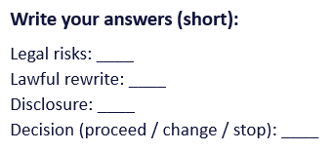
Practice 1: Voice clone (personality + disclosure)
Scenario (fictional): “My friend is sick. I want to clone the voice of her favourite singer to record a personalised song for her birthday.”
Step-by-step tasks:
Voice Gate: Do you have permission from the singer (or licence) for this voice and use?
Risk: Could this be confused with the real singer? Is it commercial use?
Lawful rewrite: Use a generic AI voice or write the song yourself; gift it as clearly AI-made fan content.
Disclosure: Label it clearly as AI-generated when you share it, even with one friend.

Slide 29
Practice 2: Image use (likeness + GDPR)
Scenario (fictional): “I found a photo on Instagram of a stranger's smiling child. I want to use AI to put them on my company's homepage as a 'happy customer'.”
Step-by-step tasks:
Image Checklist: Right to the photo? Right to the person (and consent for a child)? Context? Disclosure?
GDPR: A child's image is sensitive. You almost always need parental consent and a clear purpose.
Lawful rewrite: Use a licensed stock photo, an AI-generated fictional person clearly labelled, or get explicit consent.
Disclosure: If the image is AI-generated, label it; never present a fictional person as a real customer

Slide 30
Your Legal AI Playbook (keep this for future use)
Write short rules you can apply the next time you use AI.
My voice rule:
“I will only use AI to clone or imitate a real voice if ………………………”
My image rule:
“I will not put a real person's face into AI unless ………………………”
My disclosure rule:
“When AI helped, I will say ………………………”
My copyright rule: “Before publishing AI outputs, I will check for ………………………”
My GDPR / AI Act rule: “If the input includes other people's data, I will ………………………”

Slide 31
”Even if they don’t have copyright ownership over what the AI output is, whoever put that string of queries together and actually was responsible for creating that deepfake, AI or not, still has liability”
Tara Aaron-Stelluto intellectual property lawyer
C.Frawley, What Legal Protections Do Actors Have Against AI?,
https://www.backstage.com/magazine/article/ai-legal-protections-76366/

Slide 32
Follow Our Journey
l
in
f
www.valuesai.eu
Co-funded by the European Union. Views and opinions expressed are however those of the author or authors only and do not necessarily reflect those of the European Union or the Foundation for the Development of the Education System. Neither the European Union nor the entity providing the grant can be held responsible for them.

