Slide 1



www.valuesai.eu
MODULE 06
AI and Digital Footprint
Controlling What You Leave Behind
Co-funded by the European Union. Views and opinions expressed are however those of the author or authors only and do not necessarily reflect those of the European Union or the Foundation for the Development of the Education System. Neither the European Union nor the entity providing the grant can be held responsible for them.

Slide 2
Contents
01
Digital footprint (10 min) 3
02
Types of footprints (15 min) 8
03
The “ripple effect”: consequences for you and others (25 min) 15
04
My choice: a simple checklist + my action plan (15 min) 25
05
How to protect your digital footprint (10 min) 35
06
Audit, quiz and test (20 min) 39

Slide 3
01
Digital footprint
(10 min)

Slide 4


What digital footprint is?
A digital footprint is the collection of data about a person or organization that is left online as a result of their online activity. It includes social media profiles, posts, comments, browsing history, search queries, and information automatically recorded by websites and apps (e.g., cookies, IP address, location data).

Slide 5
Why does your digital footprint matter?
Your digital footprint can influence:
1
2
3
4
Privacy
who knows what
about you
Reputation
how you are perceived
Safety
what can
be misused
Other People
your posts can expose them too

Slide 6
Why does your digital footprint matters for AI
AI connects to your digital footprint because:
AI often uses behavioural data (clicks, viewing time, likes, searches) to predict what you want next.
Your passive footprint (permissions, location signals, device data) can influence what systems infer about you.
AI can affect visibility and reach (what content is promoted, recommended, or hidden).
Your choices also affect other people’s data (tagging, sharing images, screenshots).
Ask yourself: Where do I notice “algorithmic decisions” in my daily apps?

Slide 7
Using AI in line with values
Four value questions to guide digital decisions (especially with AI around):
Agency: Am I choosing deliberately, or just clicking automatically?
Privacy: Am I sharing more data than needed (about me or others)?
Fairness: Could this harm or disadvantage someone (now or later)?
Transparency: Do I understand who can see it and how it can spread?
Remember:
Ethical AI starts with everyday digital choices.

Slide 8
02
Types of footprints
(15 min)

Slide 9
Active digital footprint
An active digital footprint consists of data you intentionally leave when using the internet. Examples:
Posting messages, comments, photos,
Sharing information in forms and surveys,
Creating and filling out profiles on websites, companies, or platforms
With this type of footprint you have relatively more control over what you share.

Slide 10
Passive digital footprint
A passive digital footprint is data collected automatically, often without the user’s full awareness. Examples:
Browsing history and server logs,
Information stored by cookies and trackers,
Device, system, and location data (e.G., IP address),
Interactions recorded by platforms (clicks, visit time, sessions).
This footprint is usually gathered by analytics, advertising, and tracking systems, and it is harder for users to delete or fully control.

Slide 11
Together, active and passive digital footprints form a person’s overall digital footprint, and managing them (clearing history, limiting data, adjusting privacy settings) strongly affects online safety and privacy.

Slide 12
Quick activity: Sort the footprints
Task (2 minutes) and Select one:
Tagging a friend in a photo
App asking for location “always”
Liking a public post
Your device model in a photo’s metadata
Posting a story with a location sticker
Cookies tracking what you click
Screenshotting a private chat
A platform suggesting “people you may know”
Active
Passive
Both?

Slide 13

Key Takeaway: Most people underestimate their “passive” digital footprint.
When you think about your digital footprint, you might mainly think about posts, photos, and comments. But a large part of your footprint is created without you actively posting anything, through your settings, device signals, permissions, and browsing behaviour.

Slide 14
Where AI meets your footprint: everyday examples
Common AI-driven situations using footprint signals:
Ranking: what appears first in search or in your feed
Targeting: personalised ads and “suggested content”
Filtering & moderation: content flagged, reduced reach, or removed
Pattern detection: unusual login alerts or “suspicious activity” prompts
Recommendations: “For you” feeds, suggested videos, music, or products
You do not need to “build or actively use AI” to be affected by it. Many online services apply AI to personalize content, rank information, and automate decisions - often using footprint signals.

Slide 15
03
The “ripple effect”: consequences for you
and others
(25 min)

Slide 16


The “ripple effect”: online actions travel further than you expect
Online content can move quickly across people and platforms. Even small actions (a comment, a tag, a screenshot) can spread, lose context, and remain accessible longer than intended.

Slide 17
The “ripple effect”: online actions travel further than you expect
One post can lead to:
Copies: screenshots, forwards, downloads
Context loss: jokes or emotions get misunderstood without explanation
Long lifetime: old content can resurface months or years later
Wider audience: friends-of-friends, groups, or public sharing
Impact on others: people visible in your content may be affected too (probably without their consent)

Slide 18
Consequences for you: privacy, reputation, safety, and wellbeing
A digital footprint is not automatically “good” or “bad”. It depends on context and choices. However, certain patterns (oversharing, open settings, impulsive posting) can create avoidable risks for your privacy, reputation, and even your safety.
Privacy
(who can learn what about you)
Reputation
(how you
are perceived)
Safety
(what can
be misused)
Wellbeing
(stress
and conflict)
Public profiles, tags, location and permissions can reveal more than intended.
Posts may be seen without context; first impressions can form quickly and stick.
Overshared details can enable scams, account takeovers, or unwanted contact (not limited to your digital life).
Arguments, harassment, or regret after posting can affect confidence and mood.

Slide 19
Consequences for YOU: privacy, reputation, safety, and wellbeing
Example:
A photo with visible location + open profile settings can reveal where you are, who you are with, and your routine - without you explicitly writing it.
Ask yourself: Which risk is most relevant to me right now: privacy, reputation,
safety, or wellbeing? Why?
Small changes (audience settings, permissions, pausing before posting) can significantly reduce these risks.

Slide 20
Consequences for OTHERS: respect, consent, and fairness
Common ways we expose others online:
Posting or sharing content where others appear
Tagging/mentioning someone (linking them to content)
Sharing screenshots of private chats
Revealing someone’s location, schedule, or personal story
Sharing content that could cause conflict later

Slide 21
Consequences for OTHERS: respect, consent, and fairness
Concrete Example
Mini Self-Check
A “funny” screenshot from a private chat can be forwarded, misunderstood,
and used against someone - because the original context disappears
Ask yourself: Would I be okay
if someone shared the same type of content about me, without asking?
Protecting privacy includes other people’s privacy:
consent and respect are part of acting responsibly online

Slide 22
Mini-scenarios: choose the most responsible option
Scenario: A Private screenshot
A friend sends you a screenshot of a private chat and says: “This is hilarious - send it to others.”
Option 1: Forward it immediately (it is funny).
Option 2: Keep it private and ask what your friend wants to achieve by sharing it.
Option 3: Do not share it unless the people involved agree, and if in doubt, do not share.
Real-life digital decisions are often “quick moments.” This exercise helps you practise choosing an option that protects privacy, reduces harm, and respects other people, especially when content can be copied or reshared.

Slide 23
Mini-scenarios: choose the most responsible option
Scenario: A Private screenshot
A friend sends you a screenshot of a private chat and says: „This is hilarious - send it to others.”
Real-life digital decisions are often “quick moments.” This exercise helps you practise choosing an option that protects privacy, reduces harm, and respects other people, especially when content can be copied or reshared.
Your task (30–60 seconds):Choose 1 / 2 / 3
Write one sentence:
“I chose…………because………..”

Slide 24

AI & Privacy - Example
What the example about:
AI systems analyze data from everyday activities (e.g. social media, browsing, online shopping)
Personal data becomes input for training and improving AI models
Even simple online behaviors can be combined into detailed user profiles

Slide 25
04
My choice: a simple
checklist + my action plan
(15 min)

Slide 26
My choice tool: STOP-THINK-CHECK-CHOOSE
This checklist is a simple habit for safer, fairer online decisions. Use it before you post, share, tag, forward a screenshot, or accept app permissions, especially when you feel rushed or emotional.
STOP
THINK
CHECK
CHOOSE
(pause for 5 seconds):
(purpose + audience):
(privacy + people + data):
(best next step):
Am I posting fast, bored, angry, excited, or under pressure?
What is the goal (inform, joke, show off, ask for help)? Who will see it now and who might see it later?
Is the audience setting correct (public / friends / close friends / group)? Does it include other people (faces, names, messages, locations)? Does it reveal extra data (location sticker, background details, metadata)?
Post / edit / crop / blur / limit audience / ask consent / do not share.

Slide 27
Scenario 1. Practice: use the checklist before posting
You create a passive digital footprint not only by browsing, but also by what you allow apps to access.
This scenario helps you practise choosing permissions that are necessary, and declining the ones that collect more data than needed.
See the next Slide

Slide 28
Scenario 1:
You install a new app (e.g., photo editor, game, or learning app).
During setup it
asks for:
Location
Contacts
Microphone
Photos
STOP
Am I clicking “Allow” automatically just to finish
setup quickly?
THINK
What does the app actually need to do its main job? Could I use the app with fewer permissions?
CHECK
Location: does it need location “always,” “only while using,” or not at all? Contacts: is access really necessary, or only “nice to have”? Microphone: is it needed for a feature I will use? Photos/Media: can I choose „selected photos only” instead of “all photos”?
CHOOSE
Give the minimum permission needed. Prefer “only while using” over “always.” Review and change permissions later if a feature truly requires it.

Slide 29
Scenario 2. Practice: use the checklist when other people are involved
When your content includes other people, your choice affects them as well.
This scenario helps you practise making a decision that respects privacy and consent, because sharing, tagging, and forwarding can be difficult to undo.
See the next Slide

Slide 30
Scenario 2:
You have a group photo from a meeting, event, or night out. You want to post it and tag your friends. One person in the photo has previously said they do not want to be posted online.
STOP
Am I about to post quickly because I want to share the moment right now?
THINK
What is the purpose of posting? Is tagging necessary?
Who will see it now - and who might see it later?
CHECK
Consent: Has everyone agreed to be shown or tagged / Audience: Is this public, or limited to a small group /
Risk: Could this photo harm or embarrass someone later? Alternatives: Can I crop, blur, or choose a different photo?
CHOOSE
Pick the best next step: ask the person first / post without them visible / blur or crop / limit audience / do not post.

Slide 31
Scenario 3. Practice: use the checklist for app permissions
You create a passive digital footprint not only by browsing, but also by what you allow apps to access.
This scenario helps you practise choosing permissions that are necessary and declining the ones that collect more data than needed.
See the next Slide

Slide 32
Scenario 3:
You install a new
app (e.g., photo editor, game, or learning app).
During setup
it asks for:
Location
Contacts
Microphone
Photos
STOP
Am I clicking “Allow” automatically just to finish setup quickly?
THINK
What does the app actually need to do its main job? Could I use the app with fewer permissions?
CHECK
Location: does it need location “always,” “only while using,” or not at all?
Contacts: is access really necessary, or only “nice to have”?
Microphone: is it needed for a feature I will use? Photos/Media: can I choose “selected photos only” instead of “all photos”?
CHOOSE
A safer default approach: Give the minimum permission needed. Prefer “only while using” over “always.” Review and change permissions later if a feature truly requires it.

Slide 33
Three high-impact controls: small changes, big effect
You do not need to master every privacy setting to improve your digital footprint. These three controls have a strong impact across most platforms and apps - and they are realistic to check even if you are short on time.
Your digital footprint improves fastest when you control audience, location, and discoverability.

Slide 34
Three high-impact controls: small changes, big effect
Audience visibility (who can see your content): Check whether your default is public, friends, close friends, or private. Remember: “friends of friends” or open groups can still be a wide audience.
Location sharing (when your location is revealed): Avoid sharing real-time location publicly. Prefer location access “only while using” (or switch it off if not needed). Watch for hidden location clues in photos (background, landmarks, routine places).
Discoverability & contact syncing (how people can find you): Review whether your profile can be found by phone number/email. Check whether apps sync your contacts by default. Decide if you want to be searchable, or only reachable by people you choose.
Core content (self-study guidance, generic-not platform-specific)

Slide 35
05
How to protect your digital footprint
(10 min)

Slide 36
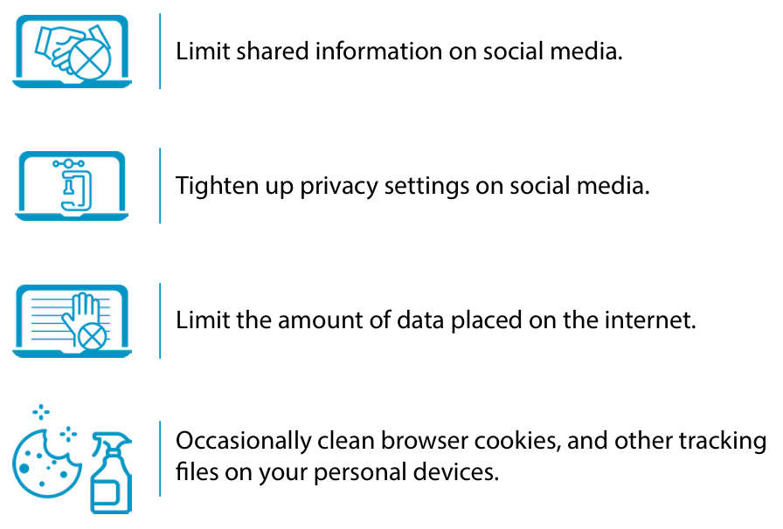
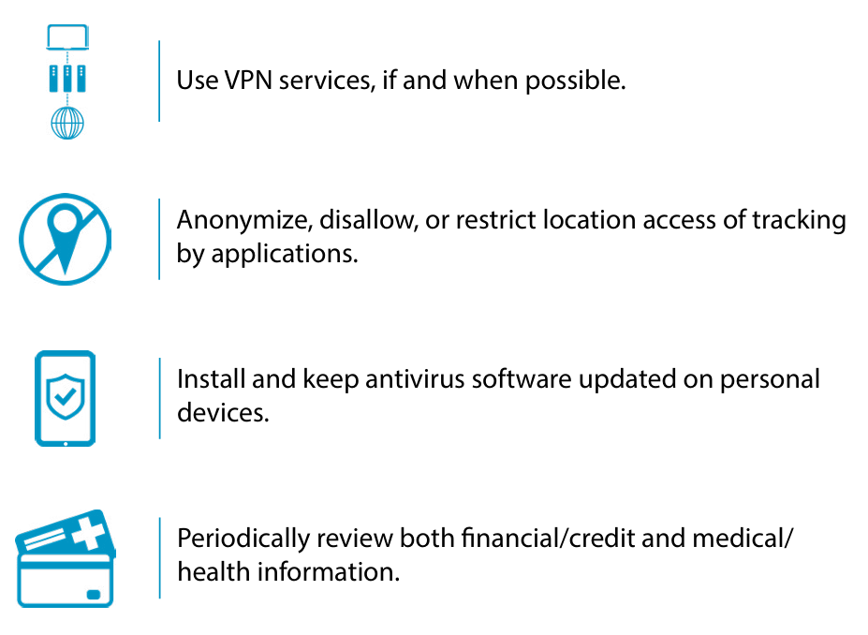
01
Practical Rules
Limit shared information on social media
02
Tighten up privacy settings on social media
03
Limit the amount of data placed on the interent
05
Occasionally clean browser cookies, and other tracking files on your personal devices
Occasionally clean browser cookies, and other tracking files on your personal devices

Slide 37
06
Practical Rules
Use VPN services, if and when possible
07
Anonymise, disallow, or restrict location access of tracking by applications
08
Install and keep antivirus software updated on personal devices
09
Periodically review both financial/credit and medical/health information

Slide 38
10
Practical Rules
Do not open attachments or access links from unknown or questionable sources.
11
Setup credit reporting notifcations
12
Continually update passwords and passwords protections, especially after being informed of a data breach

Slide 39
06
Audit, quiz and test
(20 min)

Slide 40
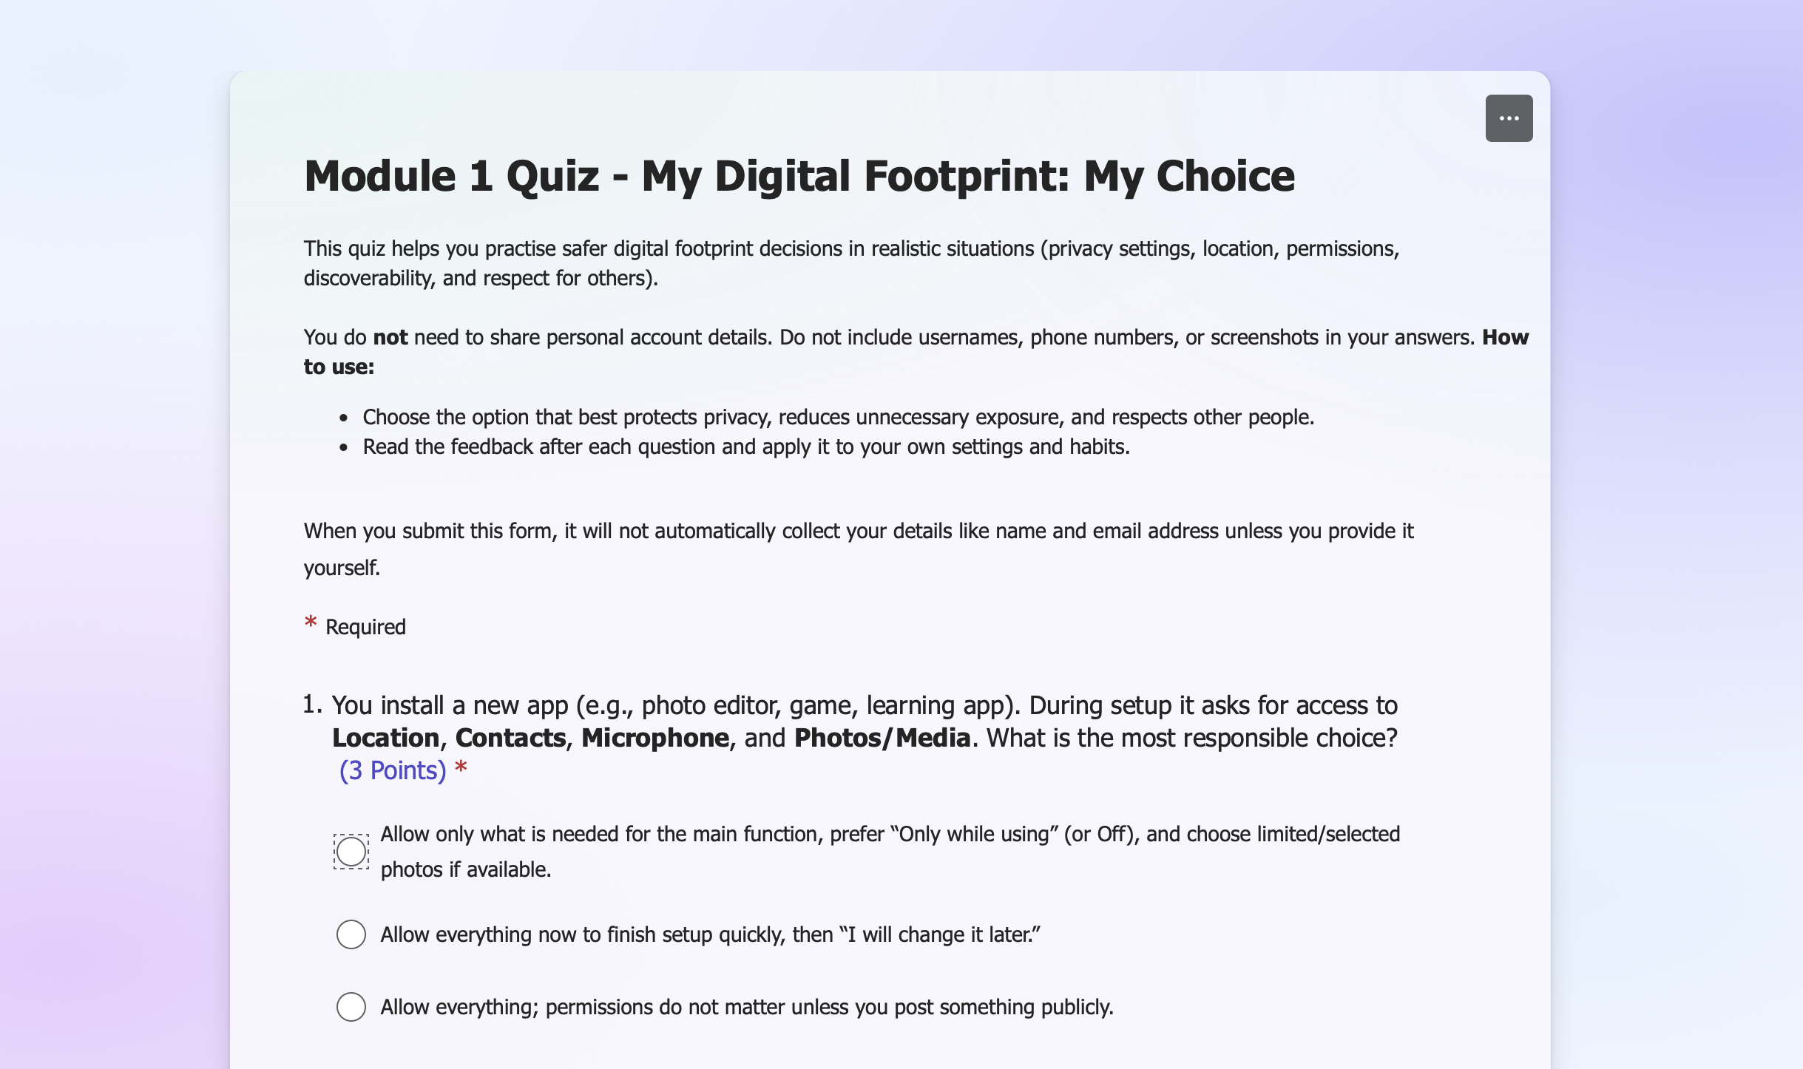
Quiz
This quiz helps you practise safer digital footprint decisions in realistic situations (privacy settings, location, permissions, discoverability, and respect for others).

Slide 41
Y N
Test: Check your digital footprint
Do you make purchases online?
Have you signed up for coupons by creating an account?
Have you registered or subscribed to newsletters or blog updates?
Have you downloaded and used shopping apps?
Have you opened a new credit card account?
Do you use a mobile banking app?
Have you bought or sold stocks?
Have you ever registered your email address with a gym?
Do you receive health care?
Unsure about your digital footprint? Answer “Yes” or “No” to the questions below, then calculate the total number of “Yes” answers to deterine the complexity of your footprint.
Source: An insider’s digital footprint and associated risks. Job aid. Defense Counterintelligence and Security Agency (CDSE), 2022 https://www.cdse.edu/Portals/124/Documents/jobaids/insider/insiders-digital-footprint.pdf

Slide 42
Y N
Test: Check your digital footprint
Have you ever used apps to track your activities and workouts?
Do you subscribe to an online publication or news source?
Have you ever reposted articles and information you’ve read?
Do you use social media on your computer or devices?
Do you interact with friends online?
Have you ever shared information, data, and photos with your online connections?
Have you ever joined a dating site or app?
Unsure about your digital footprint? Answer “Yes” or “No” to the questions below, then calculate the total number of “Yes” answers to deterine the complexity of your footprint.
Source: An insider’s digital footprint and associated risks. Job aid. Defense Counterintelligence and Security Agency (CDSE), 2022 https://www.cdse.edu/Portals/124/Documents/jobaids/insider/insiders-digital-footprint.pdf

Slide 43
Test: Check your digital footprint
RESULTS
Yes Answers <5..
A digital footprint that is less complex than most internet users
Yes Answers 5 - 12 ..
A digital footprint that is average for most internet users
Yes Answers 12+ ..
A digital footprint that is more complex than most internet users
Source: An insider’s digital footprint and associated risks. Job aid. Defense Counterintelligence and Security Agency (CDSE), 2022 https://www.cdse.edu/Portals/124/Documents/jobaids/insider/insiders-digital-footprint.pdf

Slide 44
Digital Footprint Audit
Now you will practise recognising common footprint risks and choosing practical improvements. You can also complete this without sharing personal information by using a fictional example, or optionally by checking one setting on your own device privately.
Private own-device check - Check one privacy/permission setting on your device or account. If you are working in a group, do so without sharing your screen or details.

Slide 45
Step 1: Identify 3 footprint risks
Digital Footprint Audit - Choose one of your Social Media Apps
Public visibility too wide (posts/profile discoverable)
Location revealed (real-time or routine places)
Tagging/mentions without consent
Permissions too broad (contacts/microphone/location “always”)
Personal details visible (school/work, phone, email, routine)
The goal is not to delete your online life—it is to reduce unnecessary exposure and make
your footprint intentional.
Step 2: Choose 3 Improvements (Match one to each risk)
Limit audience / switch to private / review default visibility
Remove or limit location sharing
Ask consent before tagging or posting others
Reduce permissions to „minimum necessary”
Remove sensitive details from profile
Complete these three lines:
Risk 1 → Fix 1: ______ → ______
Risk 2 → Fix 2: ______ → ______
Risk 3 → Fix 3: ______ → ______
First action (today): ______
Step 3: Decide your “first action“
What is the one change you would make first if you had only 2 minutes

Slide 46
Digital Footprint Audit
A digital footprint improves through small, consistent actions - not one perfect setting. This short plan helps you turn today’s audit into concrete steps you can actually complete.
One change I will make today (5 minutes)
Examples:
Limit profile visibility
Remove location sharing
Reduce one permission
Review discoverability
Write:
Today I will: ……………………………………………………………………………
……………………………………………………………………………………………….
……………………………………………………………………………………………….
Make it doable: If your plan feels too big, reduce it to one setting + one habit. Your digital footprint is built by habits. A small plan you follow is better than a big plan you forget.

Slide 47
Digital Footprint Audit
A digital footprint improves through small, consistent actions - not one perfect setting. This short plan helps you turn today’s audit into concrete steps you can actually complete.
Two changes I will make this week (10–20 minutes total)
Examples:
Review privacy defaults
Clean old public posts
Check app permissions
Update password settings (if relevant)
Write:
This week I will: ………………………………………………………..……………
……………………………………………………………………………………………….
……………………………………………………………………………………………….
Make it doable: If your plan feels too big, reduce it to one setting + one habit. Your digital footprint is built by habits. A small plan you follow is better than a big plan you forget.

Slide 48
Digital Footprint Audit
A digital footprint improves through small, consistent actions - not one perfect setting. This short plan helps you turn today’s audit into concrete steps you can actually complete.
One habit rule I will follow going forward (daily choice)
Examples:
”I will use STOP–THINK–CHECK–CHOOSE before sharing”
“I will ask consent before tagging”
“I will avoid real-time location”
Write:
My rule is: ………………………………………………………………..……………
……………………………………………………………………………………………….
……………………………………………………………………………………………….
Make it doable: If your plan feels too big, reduce it to one setting + one habit. Your digital footprint is built by habits. A small plan you follow is better than a big plan you forget.

Slide 49
Follow Our Journey
l
in
f
www.valuesai.eu
Co-funded by the European Union. Views and opinions expressed are however those of the author or authors only and do not necessarily reflect those of the European Union or the Foundation for the Development of the Education System. Neither the European Union nor the entity providing the grant can be held responsible for them.

