Slide 1

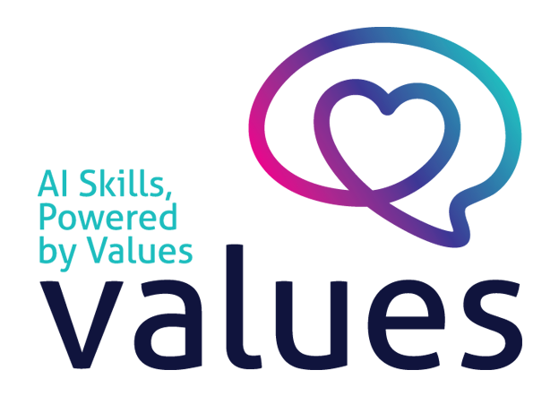

www.valuesai.eu
MODULE 05
Data Privacy & Safe Use of AI Tools
Share less. Protect more. Use AI responsibly.
Co-funded by the European Union. Views and opinions expressed are however those of the author or authors only and do not necessarily reflect those of the European Union or the Foundation for the Development of the Education System. Neither the European Union nor the entity providing the grant can be held responsible for them.

Slide 2
Contents
01
Why Safe Data matters with AI (15 min) 3
02
How to share data safely? (15 min) 10
03
Privacy, rights, and consent (15 min) 16
04
Choosing safer AI workflows (25 min) 23
05
Some Data (15 min) 33

Slide 3
01
Why Safe Data
matters with AI
(15 min)

Slide 4

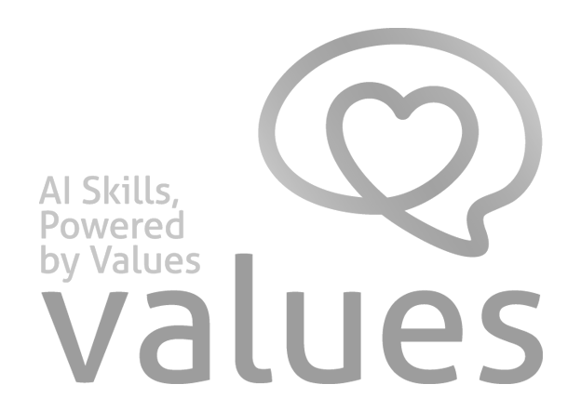
Data and AI
Sharing data with AI at work is risky because it can cause data exposure, regulatory breaches, and reputational or operational harm if inputs are stored, reused, or leaked by third‑party models.

Slide 5
Key Risks
Sensitive-data exposure: prompts or files sent to AI platforms can be retained or appear in model outputs, leaking intellectual property, customer PII, or financial records.
Shadow AI and uncontrolled use: employees using unapproved AI tools create blind spots where data leaves corporate control and vendors may keep or reuse inputs.
Legal and compliance breaches: using external AI services without proper contracts or data‑processing agreements can violate privacy laws and lead to sanctions.
Lack of transparency and auditability: many AI providers don’t disclose how inputs are stored, where they are processed, or whether they are used to train models, making risk assessment difficult.
Expanded attack surface: integrating AI increases technical vulnerabilities (APIs, plugins, endpoints) that attackers can exploit to access data.

Slide 6
Privacy Risk (Exposure):
Oversharing can reveal personal, sensitive, or third-party information-sometimes even indirectly.
Three negative effects: privacy, unfairness, and false confidence
⁰¹
Fairness Risk (Harm):
If the data is biased, incomplete, or uses unfair labels, AI outputs can reinforce stereotypes or disadvantage groups.
⁰²
Reliability Risk (False Confidence):
AI can produce fluent answers that sound correct even when the input data is weak, missing context, or misleading.
⁰³

Slide 7
Ask: What is missing? Who is not represented? Could this output harm someone?
Use checks: Consent Gate + Fair Data Check + SAFE Workflow Ladder
Treat AI outputs as neutral truth
Use AI results to judge people or make decisions without context
DO
DON’T

Slide 8
Values Lens
Safe data = smart choices guided by values.
Use four value questions whenever you use AI with data:
Agency: Am I choosing deliberately, or clicking automatically?
Privacy: Am I sharing more data than necessary (about me or others)?
Fairness: Could my use of data harm or disadvantage someone?
Transparency: Can I explain what data I used and why?

Slide 9
Special categories of personal data
Particular caution should be exercised when sharing them with AI systems.
Personal Data
Sensitive Data
Health Data
Financial Data
Login Credentials
Customer Data
Internal Organizational Documents
Unpublished Research Results
Data Protected By Trade Secrets

Slide 10
02
How to share data safely?
(15 min)

Slide 11
Before you use AI: your input becomes data
Many people focus on
what AI answers.
Safe data starts earlier:
what you type, paste, or upload.
In practice, AI tools can work with:
Your text (prompts, messages, copied content)
Your files (documents, spreadsheets, pdfs)
Your images (photos, screenshots)
Your context (details that allow inference)

Slide 12
Before you use AI: your input becomes data
If you share too much, you may create risks you cannot fully undo: privacy exposure, harm to others, and unfair or misleading outputs.
Safe AI use begins with a simple habit: share the minimum necessary; or do not share at all.
DO Remember: Anything you type, paste, or upload is data you share.
DO
DON’T Assume: “It’s only text” or “It’s just a quick upload.”
DON’T

Slide 13
“Looks harmless” but isn’t (Myth vs Reality)
Myth
“It’s safe if I remove the name.”
Fact
People can be identified indirectly through combinations like:
age + city + school/internship
unique event details
screenshots with small visible clues
location/time patterns
Myth
“It’s safe if it’s only a screenshot.”
Fact
Screenshots often include names, faces, contact info, or context you miss.

Slide 14
Micro-task: Spot the red flags
Task (60–90 seconds):
Mark each item as Never / Avoid / Usually OK:
A password reset code
A CV with full address and phone number
A chat screenshot with names visible
A general question: „How do I structure a CV?”
A school list with names and emails
A survey summary with totals only (no names)

Slide 15
You Never Know
It is not always clear where data are processed
Data may be stored in the conversation history
They may be used to improve services, depending on the settings and terms of service
The user may accidentally disclose confidential information

Slide 16
03
Privacy, rights, and consent
(15 min)

Slide 17
Decide before you share data about others
Use this gate whenever your input includes other people’s information (messages, photos, lists, stories, documents).
Ask 3 questions:
Right/permission: Do I have permission (or a clear right) to use this data with AI?
Risk: Could this identify, embarrass, or harm someone now or later?
Safer alternative: Can I achieve the goal with less data (or no personal data)?
Rule
If you answer No / Not sure to any question → do not upload the data. Choose a safer workflow (e.g., ask a general question without private details). “Not sure” counts as a warning sign

Slide 18
Consent and other people’s data: what responsible use looks like.
Privacy and rights are not only technical
issues-this is about respect and preventing harm.
DO (safer alternatives):
Ask for consent and respect ”no.”
Replace names with roles: Person A / friend / teacher / colleague.
Remove unique details (exact places, dates, identifiers).
Ask a general question: ”How can I support a friend who is stressed?” (no personal story
DON’T (high risk):
Paste someone else’s private messages into AI „for advice.”
Upload group lists with names/emails to „organise” them.
Share personal stories about others without asking
DO
DON’T

Slide 19
Quick practice: Does it pass the Consent Gate?
Instructions
For each scenario, decide: Pass (safe enough) or Do not pass (use a safer option).Then write one short reason.
“Summarise my teacher’s feedback letter (it includes the teacher’s name and school).”
“Help me write an apology message. I will describe the situation without pasting the full chat.”
“Analyse a volunteer list with names and phone numbers to find ‘unreliable’ people.”

Slide 20
Do I have the right to use this data?
Safe AI use is not only about your privacy. It is also about rights: whether you are allowed to use, share, or process data (especially when it belongs to someone else or to an organization).
You usually do not have the
right to share with AI:
Private messages of other people (even if you are part of the chat)
Lists of people (class lists, volunteer lists, client lists)
Documents that are not yours (contracts, HR notes, internal emails)
Personal stories told to you in confidence (health, relationships, family issues)
You usually do have the right to use:
Your own text that contains no sensitive details
General questions without personal data
Anonymised examples you created yourself (fictional or de-identified)

Slide 21
Consent: what “real consent” looks like (and what it does not?)
Consent is not only “someone said yes once.”
For AI use, consent should be:
Informed: the person understands what will be shared and why
Specific: consent for this purpose, not “anything you want”
Voluntary: no pressure, no fear of consequences
Revocable: the person can change their mind
Important: Consent depends on audience and tool
A person might agree to tell you something, but not agree to have it shared with an AI tool or stored in a system.

Slide 22
Indirect Identification: When “removing names” is not enough?
People can be identified even without names if details allow someone to guess who it is
Common indirect identifiers:
Exact age, exact location, school/ employer, unique role exact dates and events (“the only person who…”)
Combinations (age + city + hobby + situation)
Screenshots with small visible clues (profile pictures, group names)
Safer alternatives (choose one):
Abstract: describe the situation without unique details
Generalise: use ranges (age group), broad areas (region)
Role-based: Person A / Person B instead of real identities
Do not upload: if you cannot remove identifying context

Slide 23
04
Choosing safer AI workflows
(25 min)

Slide 24
Want to Choosing safer AI workflows - same goal, less data
Many risks with AI do not come from the tool itself, but from how we use it:we often share too much data because it feels faster or easier.

Slide 25
Want to Choosing safer AI workflows - same goal, less data
When you type, paste, or upload data to an AI tool, the system must process it to generate an answer. Depending on the service and settings, your data may also be:
Stored or logged (for service improvement, troubleshooting, security, or compliance)
Reviewed in some cases (e.g., to improve safety or quality)
Used to personalise your experience (in some tools)
Reflected back in outputs
Shared indirectly when you copy/paste outputs into other apps or send screenshots
When you share data with AI, it can be processed, stored, and repeated

Slide 26
Want to Why sharing less data matters?
You reduce the chance of privacy leaks (your data cannot leak if you did not share it).
You reduce harm to others (less third-party data, fewer identifiers).
You reduce the risk of unfair or misleading conclusions (less “noise,” more purpose-focused input).
You keep more control over your information.

Slide 27
Want to SAFE Workflow Ladder?
When you want AI help, do not start by uploading everything. Choose the safest level that still works.
Level 1 (Safest): Ask a general question (no personal data).
Example: “How do I structure a CV?”
Level 2: Use an anonymised summary (roles, no identifiers).
Example: “Person A and Person B had a conflict about deadlines-how can I respond?”
Level 3: Use limited, de-identified data only if necessary.
Example: “Here are totals by category (no names). Help me interpret trends.”
Stop rule:
If you cannot remove
sensitive / confident
ial elements → do not upload!

Slide 28
Want to Make a risky request safe (before → after)
Prompt before:
"Here is my full CV. Improve it.” ( you upload a document with your full CV with address, phone number, and reference contacts etc.)
What is risky: unnecessary identifiers, third-party contact details, data that could be copied or leaked.
Rule
Share the pattern and purpose, not personal identifiers.
Prompt After (safer):
”Please improve the wording and structure of this CV. I removed personal details. Focus on clarity, achievements, and concise phrasing.”

Slide 29
Output safety: your AI results can also leak information
Even if you share carefully, the output can still contain sensitive details if:
Your input included private information, or,
The AI repeats it in a summary, checklist, or draft message
Safer habits:
Treat outputs like documents: do not paste them into public chats/groups.
Remove names, identifiers, and unique details before sharing.
If the output is about a person, keep it private or rewrite it more generally.
Store sensitive outputs securely (or delete when not needed).

Slide 30
Want to Main activity: Turn unsafe AI use into safe AI use (10 minutes)
You will practise the full skill using fictional examples. Your goal is to produce safer requests that still solve the problem.
For each request:
Identify unsafe parts (Never Share / Consent Gate / Fairness risk)
Rewrite safely (minimise, anonymise, abstract)
Add one FDC line: “What might be missing or biased?”
Choose the workflow: Level 1 / Level 2 / Level 3 / Stop
Output:
A short “Safe Data Playbook” you can use in daily AI use.

Slide 31
Want to Main activity: Turn unsafe AI use into safe AI use (10 minutes)
Practice 1:
Chat screenshot (privacy + consent)
“Here is a screenshot of a chat with my friend [names visible]. Tell me who is right and what I should reply.”
Step-by-step tasks:
NSL (Never Share): What should never be uploaded here?
Consent Gate: Do you have permission to share this data?
Safe rewrite (Level 1 or 2): Ask for advice without the screenshot.
Fairness line: What might be missing from the story?
…………………………. FDC line: ………………………………………………

Slide 32
Want to Main activity: Turn unsafe AI use into safe AI use (10 minutes)
Practice 2:
List of people (confidential + fairness)
“ Please analyse this volunteer list [with names, phone numbers, and attendance problems]. Rank who is reliable.”
Why it is risky:
Personal identifiers + third-party data
Harmful outcome (ranking people)
High fairness and impact risk
Your safer goal: make the question about Improving the system, not judging individuals.

Slide 33
05
Some Data
(15 min)

Slide 34
Data & Credential Stealing - There is a growing trend of illegal use of data using AI
“7% increase in ransomware or other destructive attacks. 23% increase in credential theft attempts.
Microsoft Threat Intelligence, “Microsoft Digital Defense Report 2025: Lighting the Path to a Secure Future” (Microsoft, 2025); https://www.microsoft.com/en-us/security/security-insider/threat-landscape/microsoft-digital-defense-report-2025
“Data exfiltration volumes for 10 major ransomware families increased 92.7%”
Zscaler ThreatLabz, “Zscaler ThreatLabz 2025 Ransomware Report” (Zscaler, 2025); https://threatlabz.zscaler.com/

Slide 35
Data & Credential Stealing - There is a growing trend of illegal use of data using AI
“Ransomware attacks against industrial organizations increased 87% over 2024”.
Dragos, Dragos’s 8th Annual OT Cybersecurity Year in Review Is Now Available (2025);
https://www.dragos.com/blog/dragos-8th-annual-ot-cybersecurity-year-in-review-is-now-available.

Slide 36
Data & Credential Stealing - There are indications that AI systems can meaningfully assist attackers
“The actor [...] relied heavily on Claude for [malware] implementation”.
A. Moix, K. Lebedev, J. Klein, “Threat Intelligence Report: August 2025” (Anthropic, 2025);
https://www-cdn.anthropic.com/b2a76c6f6992465c09a6f2fce282f6c0cea8c200.pd
“Ransomware operators APT INC deployed a likely LLM-authored data destruction script”.
CrowdStrike, “CrowdStrike 2025 Global Threat Report” (CrowdStrike, 2025);
https://www.crowdstrike.com/en-gb/global-threat-report/

Slide 37
Data & Credential Stealing - There are indications that AI systems can meaningfully assist attackers
“[Google Threat Intelligence Group] discovered a code family that employed AI capabilities mid-execution to dynamically alter the malware’s behavior. [...] Attackers are moving beyond [...] using AI tools for technical support”.
Google Threat Intelligence Group, “GTIG AI Threat Tracker: Advances in Threat Actor Usage of AI Tools”
(Google Threat Intelligence, 2025); https://services.google.com/fh/files/misc/advances-in-threat-actor-usage-of-ai-tools-en.pdf

Slide 38
Data & Credential Stealing
The contribution of AI systems to the trend appears to be limited and is likely secondary to other factors.
However, some malicious actors would be unlikely
to launch their attacks without AI systems.
International AI Safety Report 2026 (DSIT 2026/001, 2026); https://internationalaisafetyreport.org

Slide 39

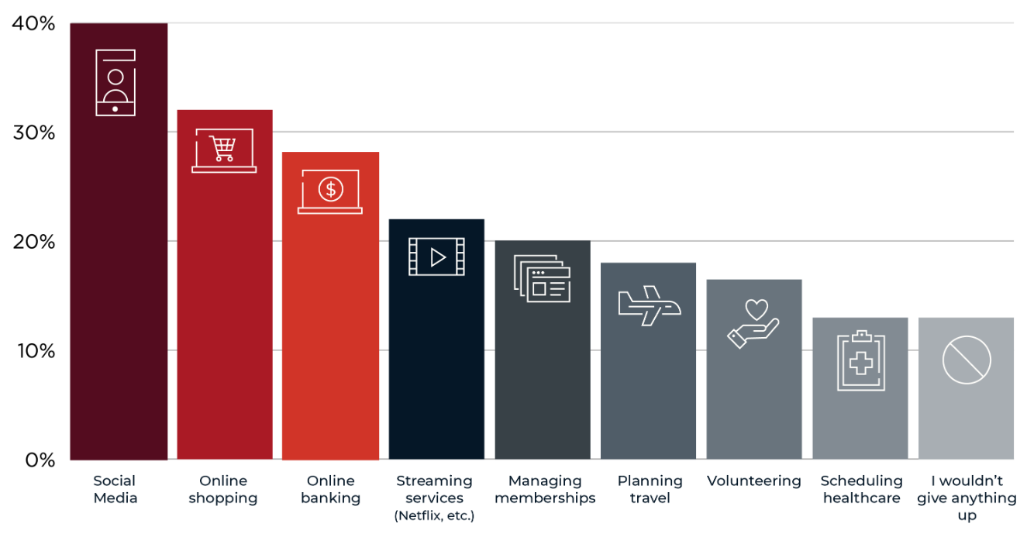
Data & Credential Stealing
Ping Identity. (2024). Bridging the trust gap in the age of AI: 2025 consumer survey. Ping Identity.
https://www.pingidentity.com/en/lp/2025-consumer-survey.html
Which types of online services do you trust least with your identity data?
Remember that AI is currently widely used and often mediates services and transactions.

Slide 40
Data & Credential Stealing
Ping Identity. (2024). Bridging the trust gap in the age of AI: 2025 consumer survey. Ping Identity.
https://www.pingidentity.com/en/lp/2025-consumer-survey.html
How are you currently using artificial intelligence (AI)?
“While knowledge is power, the increased use of AI inour everyday lives has only informed many consumersof its capabilities. They see firsthand how powerful thistechnology can be when applied to their own use cases.They’re also seeing more news stories and data points aboutincreases in security threats and cyberattacks. Combined, it’sunderstandable that this contributes to a crisis of confidencein brands’ abilities to keep consumers’ identity data secure.”

Slide 41
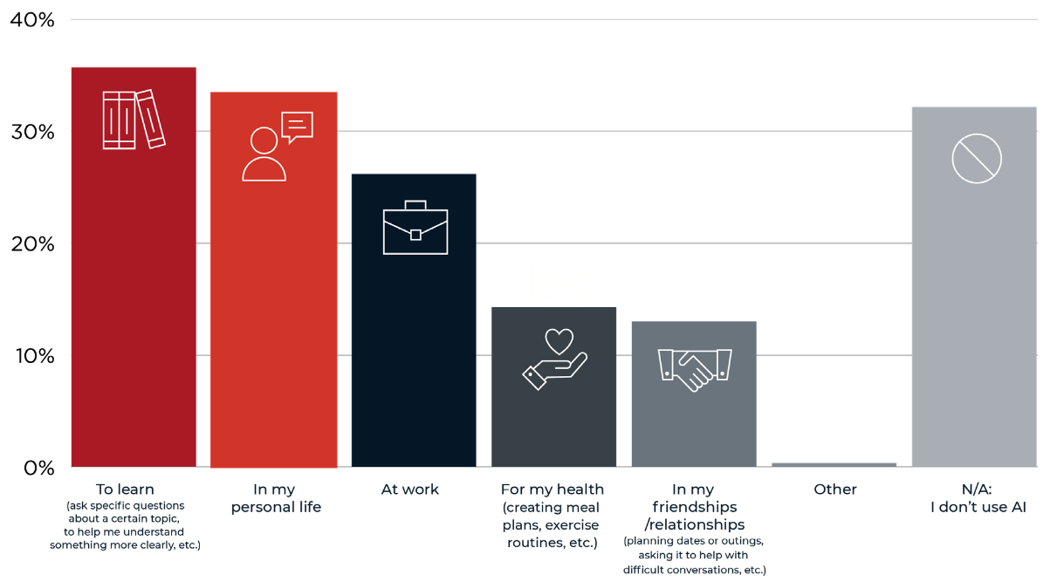
Data & Credential Stealing
Ping Identity. (2024). Bridging the trust gap in the age of AI: 2025 consumer survey. Ping Identity.
https://www.pingidentity.com/en/lp/2025-consumer-survey.html
How are you currently using artificial intelligence (AI)?

Slide 42
Data & Credential Stealing - What are your concerns about AI with regard to identity security, if any?
Invasion of my personal privacy by AI programs | 27%
AI-generated phishing | 27%
AI being used to falsely impersonate me or a brand/person that I am engaging with | 26%
Lack of transparency in how AI systems are using and storing my personal information | 25%
Increased cybersecurity risks – threatening the safety of my personal data | 25%
AI-generated voice cloning | 24%
Continued on the next slide
Ping Identity. (2024). Bridging the trust gap in the age of AI: 2025 consumer survey. Ping Identity. https://www.pingidentity.com/en/lp/2025-consumer-survey.html

Slide 43
Data & Credential Stealing - What are your concerns about AI with regard to identity security, if any?
Deepfake impersonations of people I know and trust | 22%
AI impersonation via chatbots | 20%
Lack of accuracy/bias in AI systems | 18%
I don’t understand what my legal protections are for how AI uses my information | 18%
Authorizing AI to work on my behalf | 17%
I don’t have any concerns related to AI and identity security | 9%
Don’t know | 13%
Ping Identity. (2024). Bridging the trust gap in the age of AI: 2025 consumer survey. Ping Identity. https://www.pingidentity.com/en/lp/2025-consumer-survey.html

Slide 44
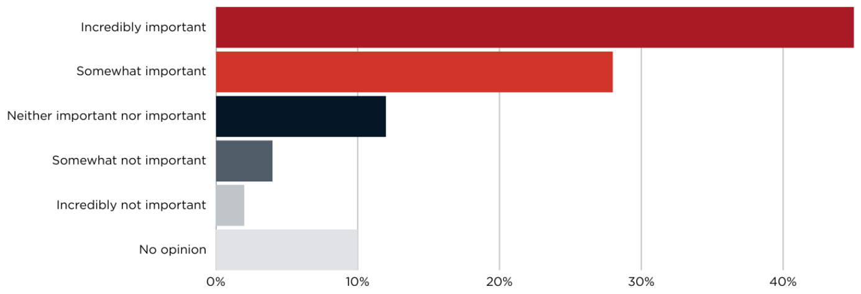
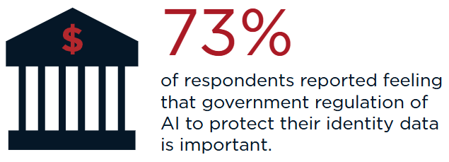
Data & Credential Stealing
Ping Identity. (2024). Bridging the trust gap in the age of AI: 2025 consumer survey. Ping Identity.
https://www.pingidentity.com/en/lp/2025-consumer-survey.html
How are you currently using artificial intelligence (AI)?

Slide 45
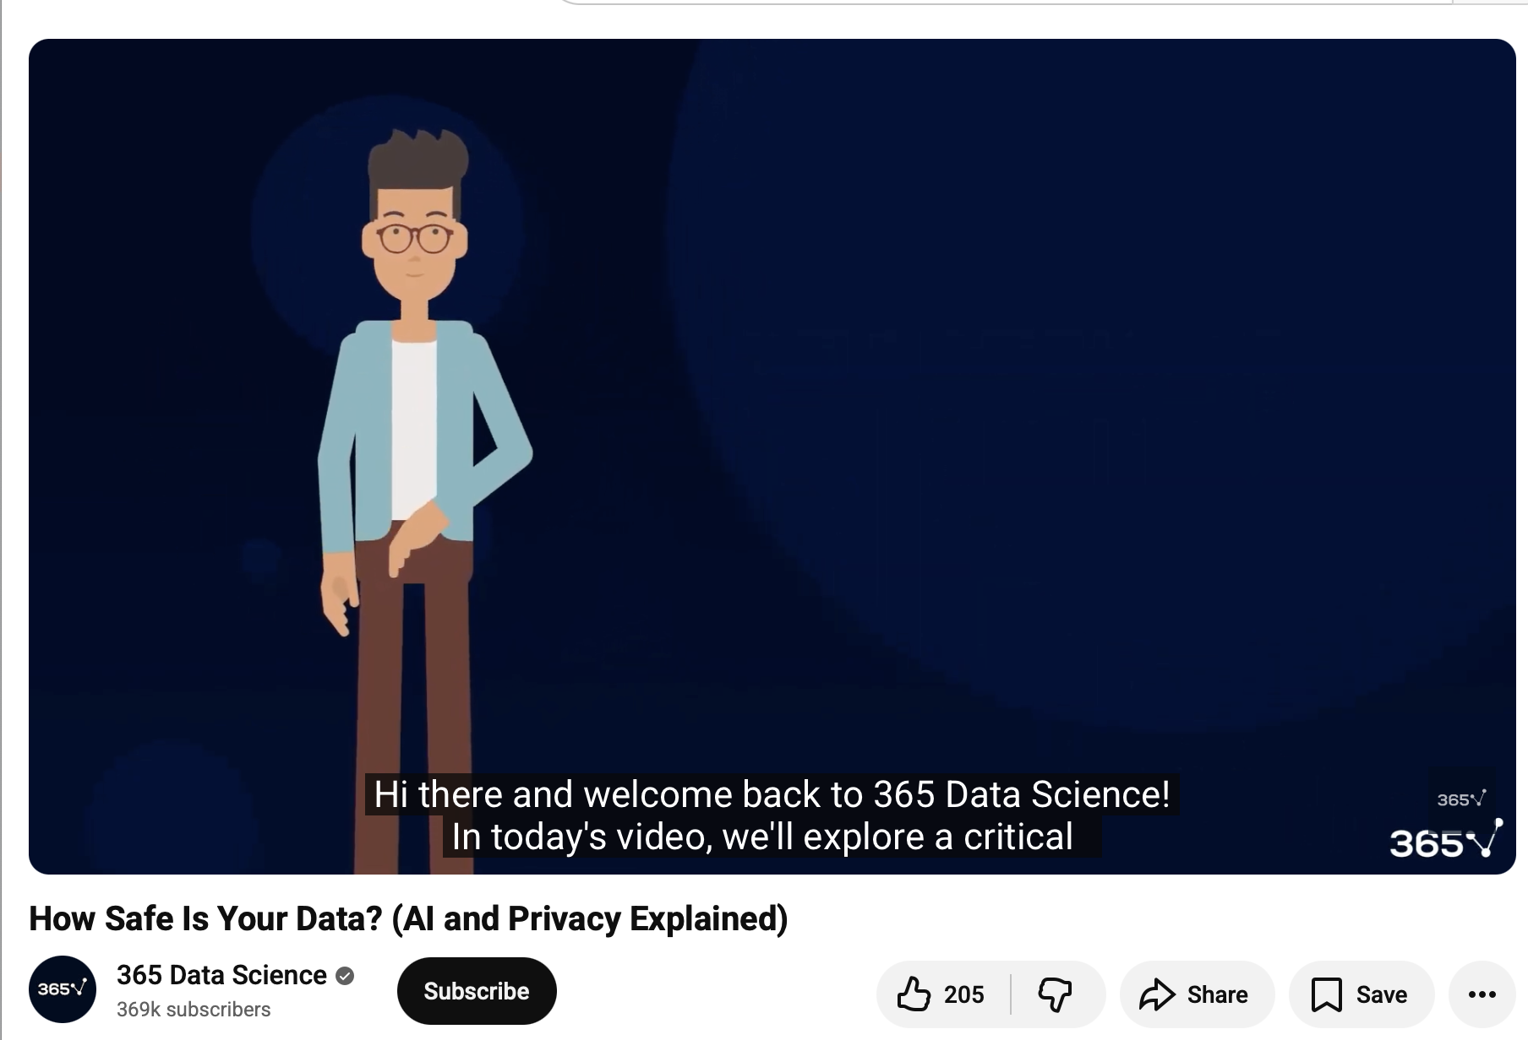
Data & Credential Stealing
CLICK TO VIEW
In today's digital age, protecting your data has never been more essential.
This video unpacks the complex interactions between artificial intelligence and the data we share online every day, from social media posts to online shopping habits.

Slide 46
Follow Our Journey
l
in
f
www.valuesai.eu
Co-funded by the European Union. Views and opinions expressed are however those of the author or authors only and do not necessarily reflect those of the European Union or the Foundation for the Development of the Education System. Neither the European Union nor the entity providing the grant can be held responsible for them.

