Slide 1



www.valuesai.eu
Reliable AI-Assisted
Content
MODULE 04
Sources, Verification and Hallucination Control
Co-funded by the European Union. Views and opinions expressed are however those of the author or authors only and do not necessarily reflect those of the European Union or the Foundation for the Development of the Education System. Neither the European Union nor the entity providing the grant can be held responsible for them.

Slide 2
Contents
01
Creating Credible Content in the AI Era (10 min) 3
02
AI Content Risks (20 min) 8
03
Accountable Author (20 min) 15
04
Working with Sources (15 min) 23
05
AI Hallucinations (10 min) 36
06
Content Verification (10 min) 45
07
Data Analysis with AI (10 min) 51

Slide 3
01
Creating Credible
Content in the AI Era
(10 min)

Slide 4


Reliable AI content
Creating credible content in the AI era is not only about producing text quickly, but above all about ensuring accuracy, transparency, and responsibility. Using AI does not automatically reduce quality, but it does require stronger human oversight, especially when the content concerns facts, data, health, politics, or social issues.

Slide 5
Reliable AI Content - Key principles
Cite sources. Refer to studies, reports, official statements, and original data.
Verify before publishing. Every piece of content should be checked for facts, numbers, and context.
Disclose AI use. Transparency increases audience trust.
Write clearly and precisely. Avoid vague wording that can lead to misinterpretation.
Update content. When new data appears or an error is found, revise the material.
Ensure clear authorship and accountability. Content should have an identifiable author or editorial owner.
Do not manipulate the audience. AI should not be used to deliberately mislead people, even if it increases reach.

Slide 6
Reliable AI Content - What Builds Trust
Credible content usually explains not only what but also why and on what basis, so combining data with expert commentary and practical examples works well.
Publication and update dates,
Links to primary sources,
An expert or author with relevant credentials,
A logical text structure,
A clear distinction between fact, opinion, and interpretation,
No sensational or clickbait-style language.
In practice, credible content in the AI era is created when AI supports the work, but humans remain responsible for truthfulness and meaning.

Slide 7
Why “reliable content” matters with AI
AI tools can produce content quickly, but every output is a draft: fluent text, plausible numbers, and convincing summaries that may still be wrong.
Why this matters:
Once published, weak content can damage your credibility and mislead your audience.
AI can fabricate citations, statistics, and quotes that look real (hallucinations).
“Reliable” means more than fluent-it means sourced, verified and accountable.
Example: Asking ChatGPT to define a concept gives a fluent answer with no sources. The same prompt in NotebookLM, with academic PDFs loaded, returns a sourced definition tied to real authors.

Slide 8
02
AI Content Risks
(20 min)

Slide 9
01
Hallucination Risk (False Facts):
AI can invent dates, statistics, names and quotes that sound real but never existed.
AI Content Carries Three Risks:
Hallucinations, Missing Sources, & AI Detection
02
Source Risk (No Foundation):
General models like ChatGPT 4.0 produce fluent text without grounding it in real publications. Bibliography is missing, vague, or fabricated.
When people use AI for content, they often focus only on speed. In practice, AI output carries three major risks.
03
Detection Risk (AI Fingerprints):
Detectors flag generic, list-like, formulaic AI text. Output without editing scores 100% AI; grounded, edited output scores under 10%.

Slide 10
“Looks reliable” but isn’t (Myth vs Reality)
Myth
“ It’s reliable if it sounds academic.”
Watch for:
Perfectly formatted citations with wrong page numbers
Real author names attached to invented papers
Plausible statistics with no verifiable source
Fluent definitions that contradict the actual literature
Fact
AI imitates academic style perfectly while still inventing facts.
Myth
“It’s safe if a detector says it’s human-written.”
Fact
Detectors only check style. Edited AI output can score 92% original and still contain hallucinations.

Slide 11
What is AI SLOP?
AI slop = low-quality, misleading, or inaccurate content generated by AI.
It sounds confident, but includes:
Fabricated facts
Wrong numbers or dates
Incorrect names, citations, or scientific claims
Repetitive, generic structure
“Smooth” text with zero real evidence

Slide 12
Why it happens?
01
The model predicts patterns, not truth – it generates the most likely response based on data, but it does not actually “know” whether it is true.
02
It may fill in gaps with invented details – when information is missing, the model can add something that sounds logical but may not reflect reality.
03
It does not always have up-to-date information – if the model’s knowledge is time-limited, it may provide outdated facts or miss recent events.
04
It may misunderstand context – an unclear question, shorthand, or ambiguity can lead to the wrong answer.

Slide 13
Why it happens?
05
It sounds confident even when wrong – the wording may appear highly reliable even if the content contains errors.
06
It can mix real facts with hallucinations – part of the answer may be correct, while other parts are invented or unverified
07
It depends on the quality of the input – if the prompt is unclear, contradictory, or incomplete, the output may be less accurate.
This is why verification becomes a key digital skill

Slide 14

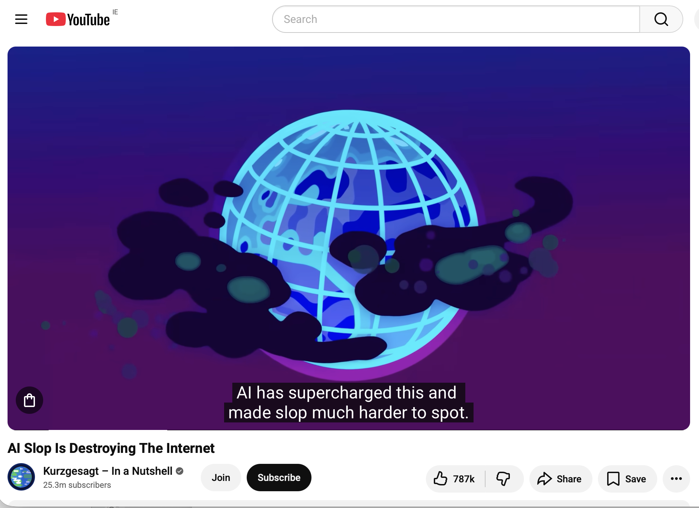
How AI SLOP destroying the Internet
CLICK TO VIEW
AI-generated content is flooding the internet, from videos and music to news and books. On top of that, generative AI is making false information look more convincing than ever. We're entering a new era of information overload, and figuring out what's real and what's not is becoming more and more of a challenge.

Slide 15
03
Accountable Author
(10 min)

Slide 16
Accountable Lens
Use four accountability questions whenever you produce content with AI:
Accuracy
Sources
Originality
Accountability
Did I check facts, dates, and quotes against trusted sources?
Can I cite real publications behind every key claim?
Did I edit the AI draft so it is not detectable as raw AI output?
Can I explain how I used AI, what I changed, and why?
Reliable content = smart use of AI guided by accountability.

Slide 17
Accountable Lens
Safe starts before AI
Rights and consent matter
Fairness is part
of safety
Safer workflows exist
What you
enter of upload matters first
Other people‘s
data needs permission
and care
Biased / low-quality data can cause harm
You can often
get AI help while sharing far less

Slide 18
Before you use AI: every output is a draft
Many people focus on AI speed. Reliable content starts earlier: what you verify, ground, and edit.
In practice, AI tools generate:
Definitions and explanations (often without sources)
Summaries of papers (sometimes invented or distorted)
Lists of references (frequently fabricated)
Data analyses and interpretations (without methodology)

Slide 19
Before you use AI: every output is a draft
Reliable AI use begins with a simple habit: treat every output as a draft to verify, not a final answer.

Slide 20
AI output is a draft, not truth
What counts as content
you must verify:
Definitions and theoretical claims
Statistics, percentages, and dates
Names of authors, books, and articles
Data analyses and conclusions
DO Remember: Every fact, citation, and number from AI must be checked before use.
DO
DON’T Assume: "It sounds professional” or "It must be true if AI said so.”
DON’T

Slide 21
The Never Trust List (NTL)
If it cannot be traced to a verified source-do not publish
Do not publish without checking:
Citations: any reference to a book, paper, or author the AI named
Quotes: any “direct quote” the AI attributes to a person
Statistics: percentages, sample sizes, study results, rankings
Historical facts: dates, events, locations, names of laws or treaties
Definitions and theories: claims about what a concept “is” or who proposed it
Numerical analysis data: client lists, HR data, internal documents, non-public figures

Slide 22
How to make AI output more reliable (before you publish)
Before publishing AI output, apply these checks:
Verify citations: open in Google Scholar, Scopus, or publisher site
Cross-check every statistic with at least one independent source
Re-run the prompt in a grounded tool (e.g., NotebookLM with real PDFs loaded)
Edit structure, replace generic phrases, add specific examples
If you cannot find the source of a claim → do not publish it

Slide 23
04
Working with Sources
(15 min)

Slide 24
Sources Provided
by AI
01
Using credible sources – choose materials from reputable journals, public institutions, scholarly databases, and expert organizations.
02
Distinguishing scholarly, industry, media, and opinion sources – each source type serves a different function and offers a different level of reliability.
03
Checking publication dates – currency matters, especially in fast-changing fields where AI may provide outdated information.
04
Verifying citations – check whether the cited author, title, year, and quoted claim actually exist and match what the text or AI says.

Slide 25
Sources Provided
by AI
05
Distinguishing primary and secondary sources – a primary source presents original material, while a secondary source discusses or interprets earlier work.
06
Cross-checking information – important claims should be confirmed in at least two or three independent sources.
07
Evaluating the author, publisher, and purpose – always ask who wrote the text, where it was published, and whether its goal is to inform, sell, persuade, or comment.

Slide 26
Example of AI providing an incorrect source
This slide shows a ChatGPT 5 Instant conversation where the user asks about how the COVID-19 pandemic changed consumer behavior and brand strategies. The AI provides a structured response with citations to academic sources (Pantano et al., 2020; Sheth, 2020; Liu et al., 2021; He & Harris, 2020), discussing digitalization of consumer behavior and new consumer priorities including safety, health, trust, and ”mindful consumption.”
When the user verified one citation, they discovered that the article „The challenges and opportunities of digital transformation in the post-COVID-19 world” was NOT published in Technological Forecasting and Social Change as the AI claimed, but rather in IEEE Engineering Management Review, Vol. 48(3), pp. 97-103.
See the next slide

Slide 27
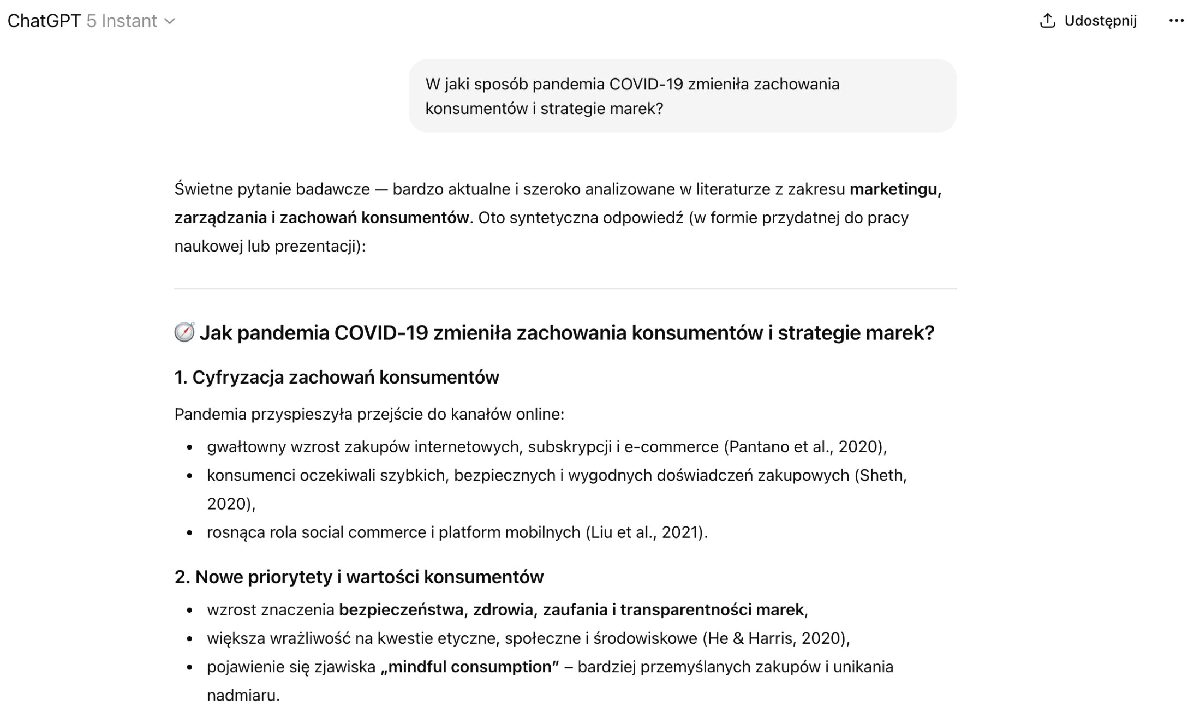
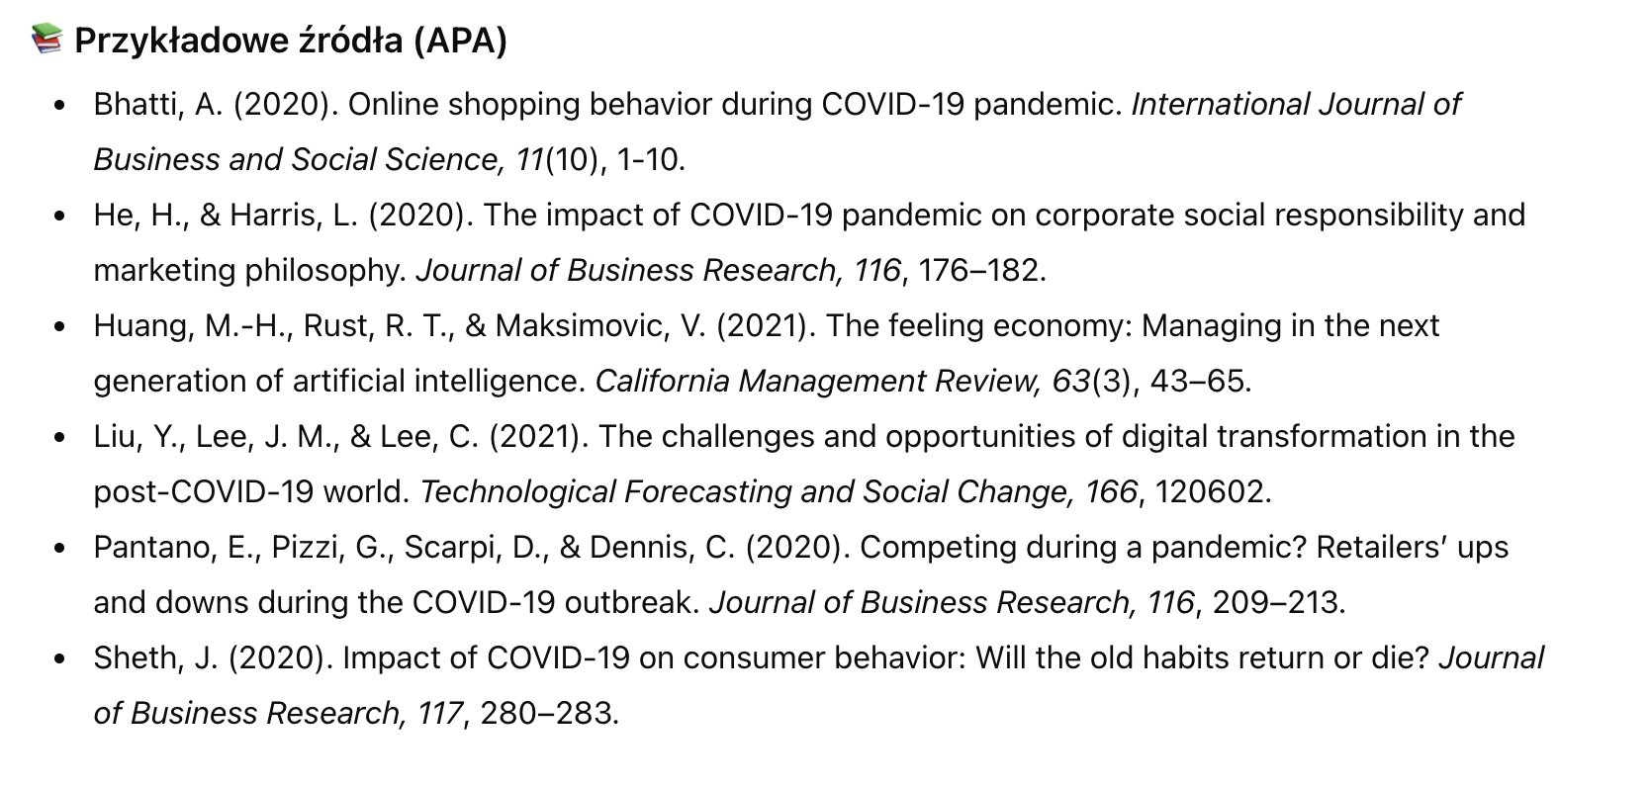
Example of AI providing an incorrect source

Slide 28
Example of AI providing an incorrect source. Conclusion
The AI misattributed a real article to the wrong journal, incorrectly citing it as published in Technological Forecasting and Social Change instead of IEEE Engineering Management Review.
It generated a plausible but false bibliographic reference, including journal name and publication details, creating a misleading APA-style citation.
The AI failed to verify publication metadata (journal, publisher, DOI) despite the source being easily verifiable.
It combined a real title with an incorrect publishing context, a typical case of source hallucination.
This error undermines academic reliability, potentially leading to incorrect bibliographies and issues during peer review.
See the next slide

Slide 29
Example of AI providing an incorrect source. Conclusion

Slide 30

Example of AI providing an incorrect source. Conclusion
AI can effectively summarize literature, but all AI-generated references must be independently verified before use in academic work.

Slide 31
Exercise
Ask any AI model to generate a one-page A4 write-up on any topic. Ask it not to use websites, but instead to rely on publications such as articles, books, reports, and similar sources
Create a list of sources.
Then, according to good practice, verify the accuracy of the sources provided: do they really exist?
Are they accessible?
Do they list the correct authors? .
If you detect an AI mistake, share your observations with the group and the instructor.

Slide 32
Scenario: ChatGPT 4.0 vs NotebookLM
A research case study compared two tools on the same task: “Generate a definition of innovation strategy with a bibliography.”
The same prompt produced two outputs that show what grounding changes:
ChatGPT 4.0: fluent definition, no real bibliography, detected as 100% AI by Originality.ai.
NotebookLM (with real PDFs): grounded definition citing real authors (Porter, Janasz, Pomykalski, Freeman); 92% original score.
What this means in practice:
Without grounding, AI invents fluent but unsourced content. With a real knowledge base, the same model produces verifiable text tied to specific publications.

Slide 33
ChatGPT 4.0 vs NotebookLM: what grounding changes
Sources are not just academic - they are what make AI output accountable.
ChatGPT 4.0
(no grounding):
I m NotebookLM
(with PDFs loaded):
Fluent text, simplified definitions, no bibliography
Plausible company examples (Google,
Tesla, Apple) with no „studies” behind them.
100% detected as AI-generated by Originality.ai
Theory-grounded definitions citing Porter, Janasz, Pomykalski, Freeman
Real research traditions: innovation typologies, network economy, SME context.
Concrete bibliography in APA format, ready to verify
Style scored 92% original by Originality.ai

Slide 34
Sources and Rights: “Do I have a real reference for this claim?”
Reliable AI use is not only about facts. It is also about authorship: who wrote the original idea, whose work you cite, and how you credit it.
You can usually rely on AI cannot trust AI output for:
Exact statistics, percentages, sample sizes
Specific quotes attributed to named authors
Publication years, page numbers, journal titles
Definitions of niche or recent concepts not in mainstream literature
General explanations of well-known concepts
Structural editing (grammar, flow, paragraphing)
Summarising text you have provided to AI yourself

Slide 35
What a “real reference” looks like (and what it does not)
Reliable AI use is not only about facts. It is also about authorship: who wrote the original idea, whose work you cite, and how you credit it.
A real source is not only a name and a year. For AI-cited references, a source must be:
  Real: the publication actually exists and is findable in a database
  Specific: matches the claim word-for-word, not just the topic
  Accessible: you can open it and read the relevant section
  Authoritative: published by a credible journal, publisher, or institution
  Important: Consent depends on audience and tool
  A person might agree to tell you something, but not agree to have it shared with an AI tool or stored in a system.

Slide 36
05
AI Hallucinations
(10 min)

Slide 37
What AI hallucinations are?
AI hallucinations are model-generated answers that sound plausible but contain false, invented, or misleading information. The model does not „know” what is true - it usually predicts the most likely text rather than checking reality.
AI hallucinations occur when a system produces content that appears correct but is factually wrong, such as a fabricated quote, a nonexistent source, an incorrect date, or a misleading explanation. These are not medical hallucinations — they are information-generation errors, not perceptual experiences.

Slide 38
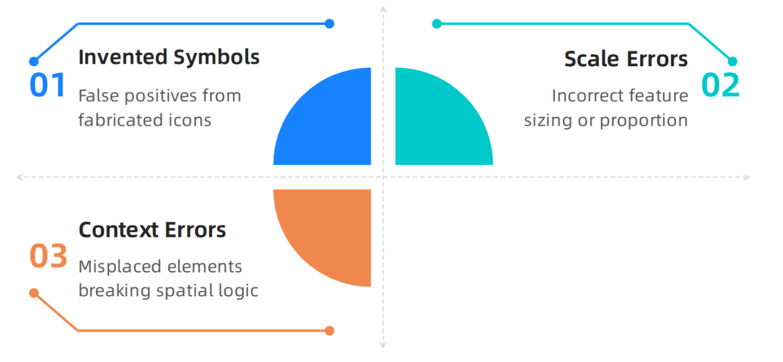
AI Hallucinations Map
How to detect and fix AI hallucinations in graduated symbol
maps. Aihallucinationreport.com. https://aihallucinationreport.com/how-to-detect-and-fix-ai-hallucinations-in-graduated-symbol-maps/

Slide 39
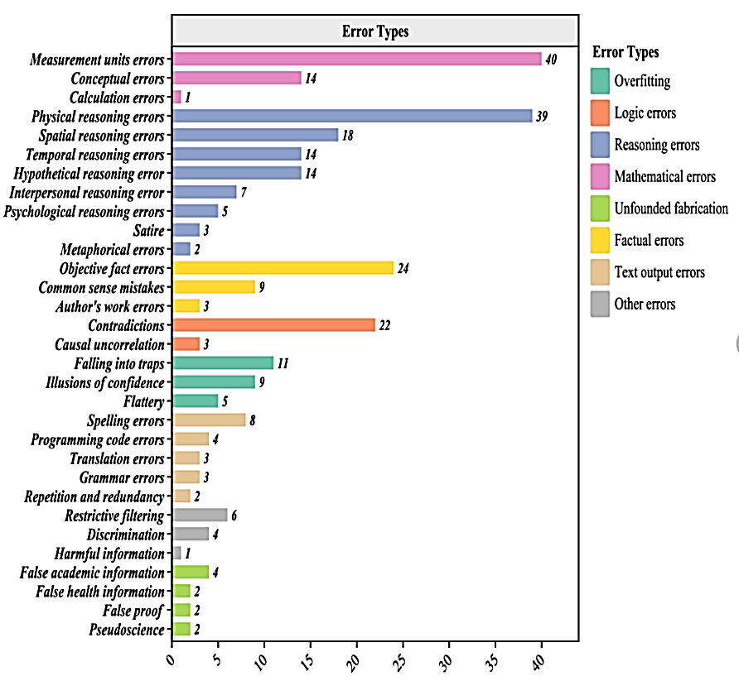
AI Hallucinations
Statistics for 284 analysis units. Different colors represent different error types.
Sun, Yujie & Sheng, Dongfang & Zhou, Zihan & Wu, Yifei. (2024). AI hallucination: towards a comprehensive classification of distorted information in artificial intelligence-generated content. Humanities and Social Sciences Communications. 11. 10.1057/s41599-024-03811-x.

Slide 40
Types of AI Hallucinations
01
Factual Hallucinations – the model states false facts, events, people, or definitions.
02
Source Hallucinations – AI invents sources, publications, authors, titles, or assigns claims to nonexistent texts.
03
Quote Hallucinations – the model gives a quote that was never actually said or falsely attributes it to a person.
04
Numerical Hallucinations – AI miscalculates data, confuses percentages, dates, statistics, or table values.

Slide 41
Types of AI Hallucinations
05
Contextual Hallucinations – the model misunderstands the question or adds details the user did not intend.
06
Mixed Hallucinations – the answer contains both correct facts and invented elements, making the error harder to spot.

Slide 42
Causes of AI Hallucinations
01
The model predicts patterns, not truth – it generates the most likely words rather than checking facts.
02
Training data may be incomplete or flawed – if the data contain gaps, errors, or contradictions, the model can reproduce them.
03
Lack of up-to-date information – the model may not know recent events or changes.
04
Unclear prompt context – with ambiguous or shorthand prompts, the model may misread the user’s intent.

Slide 43
Causes of AI Hallucinations
05
Systems reward fluent answers – models are often trained to respond confidently and smoothly, even when uncertain.
06
No built-in fact checking – without access to external sources, the model cannot verify whether its answer is true

Slide 44
Indirect Hallucinations: when names and dates look right but aren’t
Common Indirect Hallucinations:
Safer Alternatives:
Real author + real journal + invented paper title
Real paper + wrong year, page, or volume number
Real concept + wrong author (“porter said” when schumpeter did)
Real statistic + invented context (right number, wrong study)
Search: open google scholar and confirm the exact paper exists
Replace: cite a paper you have actually read on the same topic
Soften: use general phrasing if you cannot pin down a specific source
Remove: if you cannot find the source, delete the claim entirely
AI can hallucinate even when names, dates and titles look correct.
The pattern is plausible but the link to the original work is broken.

Slide 45
06
Content Verification
(10 min)

Slide 46
AI-generated content can be useful, but it should not be published or used without prior verification
Check claims, numbers, quotes, and sources
before using them.
Treat the AI answer as a draft, not as final truth.
Document what was verified and on what basis.

Slide 47
Step 1: Identify Risk & Key Claims
Which elements could cause harm if they are wrong?
First, identify which parts of the AI response require mandatory checking: facts, dates, names, numbers, quotes, definitions, and cited sources. The greater the impact on health, law, education, finance, or reputation, the stricter the verification should be.
Did the AI provide real sources, or does it only sound convincing?
What in this answer is fact, and what is interpretation?

Slide 48
Step 2: Verify Facts & Sources
Confirm the information in at least two independent sources.
Every important claim should be checked against credible external sources, preferably primary ones: scholarly articles, reports, public institution websites, and reputable industry publications. Never assume that a source cited by AI actually exists — verify the author, title, year, accessibility, and whether the source truly contains the stated information.
Open the original source, not only a summary or repost.
Check the publication date and currency of the information.

Slide 49
Step 3: Assess Quality, Language, & Context
The text mixes facts with opinion.
After checking the facts, assess whether the text is logical, clear, balanced, and appropriate for its purpose. AI may produce content that is formally correct but poorly contextualized, overly confident, biased, or stylistically unsuitable.
It contains bias, oversimplification, or excessive generalization.
The tone and style fit the audience and publication goal.

Slide 50
Edit, Decide, & Document
Finally, correct errors, remove uncertain fragments, and decide whether the content
is fit for use. Good practice is to record what was changed, what was rejected,
and which sources confirmed the final version of the text. Final decision:
1
2
3
Publish
Hold
Reject
If the content has been checked and corrected.
If some information remains uncertain.
If the content contains too many errors or lacks source confirmation.

Slide 51
07
Data Analysis with AI
(10 min)

Slide 52
When you analyse data with AI, validation is the work
When you ask AI to analyse data, the system will generate a fluent narrative. Depending on prompt and tool, the output may also:
Skip the methodology (no mention of sample size, method, or assumptions)
Average over outliers without flagging them
Generalise from a small sample (e.g., n=10 respondents)
Produce confident conclusions (where data only supports tentative ones)
Confirmation bias: AI repeats the framing of your prompt back to you

Slide 53
When you analyse data with AI, validation is the work
Why validating analysis matters:
You catch errors before they reach a report or publication.
You distinguish strong findings from confident-sounding noise.
You avoid drawing decisions from unrepresentative samples.
You keep authorship of the analysis - not the model

Slide 54
LEVEL 1
SAFE Analysis Ladder: choose the most verifiable level
When you analyse data with AI, do not start at the top of the ladder. Choose the lowest level that still answers your question.
(Most reliable): Ask a general question (no personal data).
Example: “Explain when a t-test is appropriate vs Mann-Whitney U.”
LEVEL 2
Use an anonymised summary (roles, no identifiers).
Example: “Mean = 4.2, SD = 1.1, n = 120 - what does this suggest about the trend?”
LEVEL 3
Stop rule: If you cannot remove sensitive/confidential elements → do not upload
Use limited, de-identified data only if necessary.
Example: “Here is the dataset. Compute X, then I will recheck against my own calculation.”

Slide 55
Unreliable AI output (realistic):
“AI ran sentiment analysis on 200 tweets about our brand. 67% positive. Therefore brand sentiment is strongly positive.”
Conclusion from Small Data
What is unreliable?
“67%” with no methodology, no model, no validation
200 tweets is a tiny, possibly biased slice
“strongly positive” overstates what the number shows

Slide 56
Follow Our Journey
l
in
f
www.valuesai.eu
Co-funded by the European Union. Views and opinions expressed are however those of the author or authors only and do not necessarily reflect those of the European Union or the Foundation for the Development of the Education System. Neither the European Union nor the entity providing the grant can be held responsible for them.

