Slide 1



www.valuesai.eu
MODULE 03
Disinformation, Deepfakes & Data Manipulation
Recognising and Preventing AI-Driven Deception
Co-funded by the European Union. Views and opinions expressed are however those of the author or authors only and do not necessarily reflect those of the European Union or the Foundation for the Development of the Education System. Neither the European Union nor the entity providing the grant can be held responsible for them.

Slide 2
Contents
01
Disinformation (20 min) 3
02
Deepfakes (20 min) 8
03
Data & Context Manipulation (15 min) 17
04
Your Detective Toolkit (20 min) 29
05
Content creator responsibility & the
consequences of disinformation (15 min) 41
06
Exercises and examples (25 min) 47

Slide 3
01
Disinformation
(20 min)

Slide 4


Disinformation
AI‑supported disinformation – refers to deliberately false or misleading content that is created, edited, or disseminated with the use of artificial intelligence tools (such as generative models, deepfakes, or bots) in order to deceive the public, influence perceptions, and cause harm to democratic processes, institutions, or individuals.

Slide 5

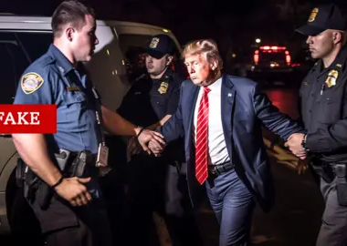
An Example of Disinformation
One of the most famous and well‑documented examples of AI‑supported disinformation is the fake image of Donald Trump being arrested, which circulated on social media and news platforms in Europe and the US in 2023.
The photo showed Trump being taken away by police, although no such arrest ever took place – the image was fully generated by an AI image– generation tool based on real archival footage and photos.
Many of those sharing the images pointed out they were fake, and they did not appear to fool lots of people - but a few did seem to be tricked.

Slide 6
Discussion Exercise
We’ll know our disinformation program is complete when everything the American public believes is false.”
William J. Casey, Director of the CIA
Consider what potential economic and social consequences such a message may cause.
Are the harms caused by such activity fully reversible?
The medium carrying by far the greatest risk of disinformation is the Internet. Think about why this is the case.
Conduct a group vote on whether you trust television news more or news coming from the Internet. How does the result of your vote correspond to the risk of disinformation?

Slide 7
Misinformation, disinformation and
manipulation are not the same thing.
Misinformation
Disinformation
Manipulation
False or inaccurate information spread not necessarily intentionally
False information deliberately created and disseminated
Changing content, context, or data in order
To influence the recipient

Slide 8
02
Deepfakes
(20 min)

Slide 9
Deepfakes: Why They’re Difficult to Detect
A deepfake is a piece of media created or altered using artificial intelligence to make it look as though someone said or did something they never did. Sophisticated algorithms can blend real footage with computer‑generated imagery and audio so seamlessly that it’s often impossible to tell just by looking or listening.
This technology has improved rapidly. It no longer leaves obvious glitches or “tells” like mismatched lips or blurred backgrounds. That’s why even experienced journalists and digital forensics experts can struggle to spot a well‑made fake.

Slide 10
Deepfakes: Why They’re Difficult to Detect
Deepfakes can be used for humour or art, but they are increasingly being used to mislead or harm. They can damage reputations, spread false information or be weaponised in political or personal attacks. Their realism is why we need to develop a cautious, questioning mindset when we encounter surprising content online.

Slide 11
Want to put your digital detective skills to the test?
The MIT Media Lab’s Detect Fakes website gives you the chance to watch real and AI‑generated videos and decide which is which.
  Researchers built this tool to help people learn by doing – there’s no single trick to spotting a deepfake, but by paying attention to small details in faces and lighting, you can start to tell when something has been manipulated.

Slide 12
01
Your Reflection Toolkit
What clues make you suspect a video or photo could be fake?
Throughout this session you will see moments where we ask you to pause and think about what you have just seen or heard. We encourage you to take notes in a notebook, on your phone or in a notes app.
02
What thoughts or questions come to mind, especially if something doesn’t feel right?
There is no single correct answer; these notes are for your own use and to help you build a habit of questioning what you see online. The goal is to develop your digital detective skills and learn how to navigate uncertainty with confidence.
03
Why might someone create and share a fake?

Slide 13
01
Have you ever seen a deepfake or suspected that a video was manipulated? How did it make you feel?
What do you think?
Understanding what deepfakes are and why they are difficult to detect will help you to use the three‑point checklist later on in this module.
02
Knowing how real these fakes can seem, what extra steps do you think you should take before believing or sharing a startling clip?
03
How might deepfake technology be used in positive ways and how can we prevent misuse?

Slide 14
01
How quickly do you share an interesting or funny AI image or clip? How do you decide whether to share?
Think: Navigating Uncertainty
These activities are designed to build your critical thinking skills and help you navigate a digital world where facts and fiction often overlap.
02
What is the difference between a funny AI image or clip and one that does people harm?
03
Who might benefit when AI misinformation spreads?

Slide 15
01
Fake Videos – video recordings in which a person appears to say or do things they never actually said or did, created or altered using AI (e.g., deepfakes)
Types of AI‑generated false content – definitions & examples
02
Fake Comments/Reviews – AI‑generated opinions, ratings, or comments online designed to artificially build a positive image of a product, company, or politician
03
Synthetic Accounts & Bots – fake user profiles or bot accounts controlled by AI that mimic real users in order to increase the reach of false content
04
Automatically Generated Influence Campaigns – information campaigns whose content (texts, graphics, video, social media posts) is partially or fully generated by AI and automated for mass dissemination

Slide 16
05
fake news – articles or headlines in media that are created or modified by AI to look like legitimate news, but in fact contain false or distorted information
Types of AI‑generated false content – definitions & examples
06
fake quotes – statements falsely attributed to celebrities, politicians, or scientists, generated by AI in the form of „quotations”
07
fake images – graphics or „photos” of events that never occurred (e.g., political arrests, disasters, social events), created by AI image generators
08
fake voice recordings – synthetic voices of public figures used to create fake audio clips, conversations, statements, or speeches

Slide 17
03
Data & Context Manipulation
(15 Min)

Slide 18
Manipulation of Data Content Typically Concerns
Selective presentation of data – showing only the part of the dataset that supports a claim while omitting the rest.
Changing the chart scale – using a truncated axis or uneven intervals so that small differences appear much larger.
Omitting the source – presenting a number, chart, or quote without indicating the source, methodology, or date.
False statistics – presenting invented, incorrect, or mathematically flawed numbers.

Slide 19
Manipulation of Data Content Typically Concerns
Taking a statement out of context – showing only a short excerpt in a way that changes the original meaning.
Combining true data with a false interpretation – using correct figures but drawing a misleading or manipulative conclusion from them.
Selective choice of time frame – choosing the start and end dates so the data artificially suggests growth, decline, or crisis.
Manipulative category or sample selection – grouping data or choosing the sample in a way that makes the result look more convincing than it really is.

Slide 20
Practical Examples
Hiding the Trend
Let us assume that we want to present the sales values of four products offered by our company. Unfortunately, product B (red colour), which is the cornerstone of our offer, is not selling as well as it did earlier. No problem – we can easily hide this.
When using a stacked bar chart, we can make the sales decline go unnoticed or at least make it appear less drastic than it really is. When visualizing the same data on a line chart, we can clearly see the true picture of the situation – the downward trend is clearly visible. It is hard to believe that both charts present the same data, isn’t it?
See the next slide

Slide 21
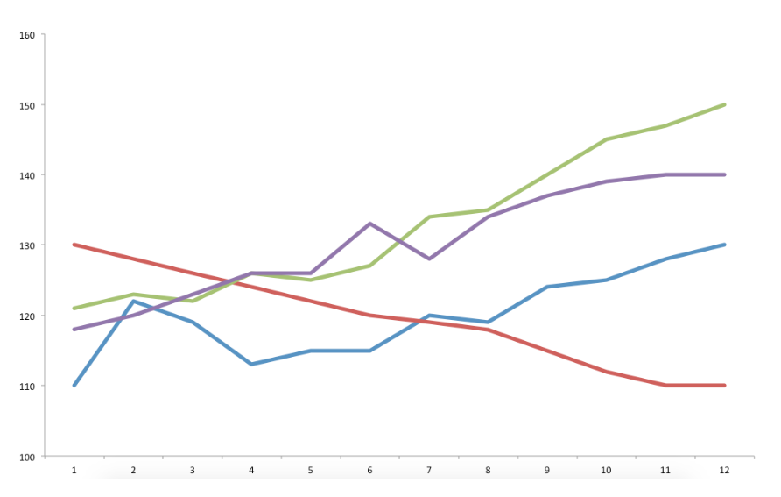
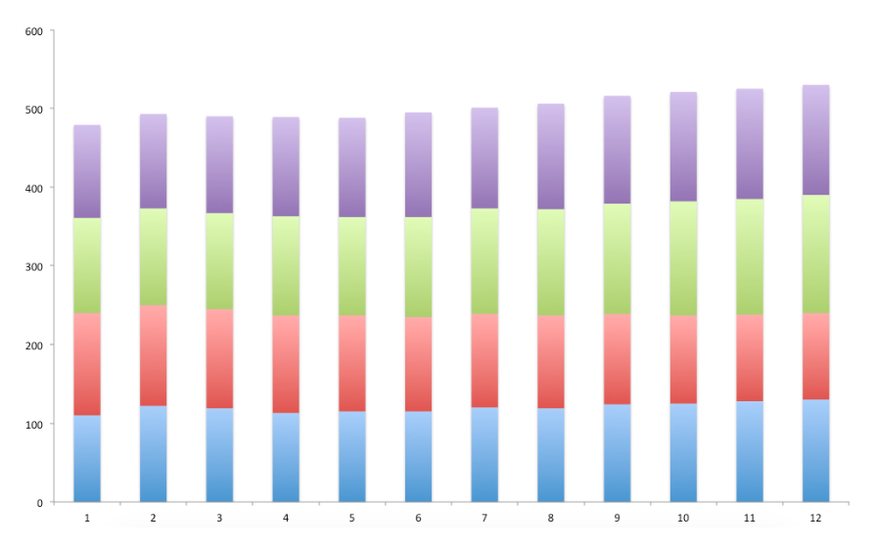
Hiding the Trend
ICAN. (n.d.). A short guide to manipulation in data visualizations. Retrieved May 17, 2026, from https://www.ican.pl/b/krotki-przewodnik-po-manipulacji-wizualizacjami-danych/16IwGIn0h

Slide 22
Practical Examples
Scale Change
On the first chart, the scale starts at 0. We can see that the difference, for example, between bars 2 and 7 is not significant.
On the second chart, the same data are visualized again. In this case, the scale starts at 100. Here the differences between the individual bars are significant.
See the next slide

Slide 23
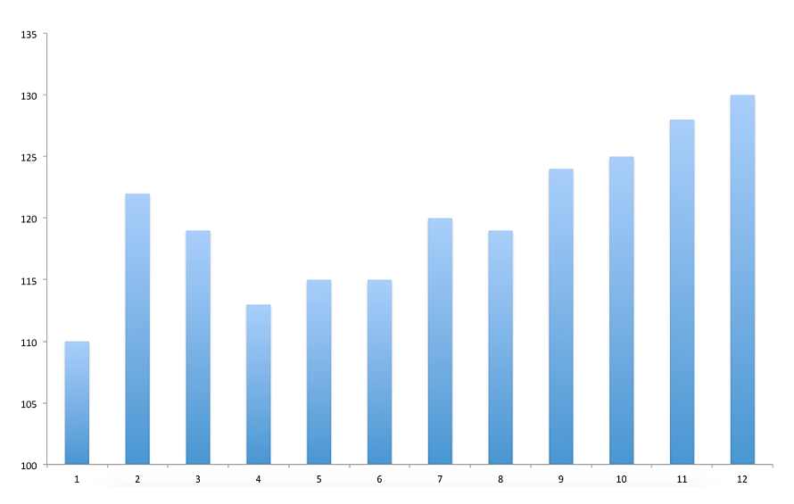
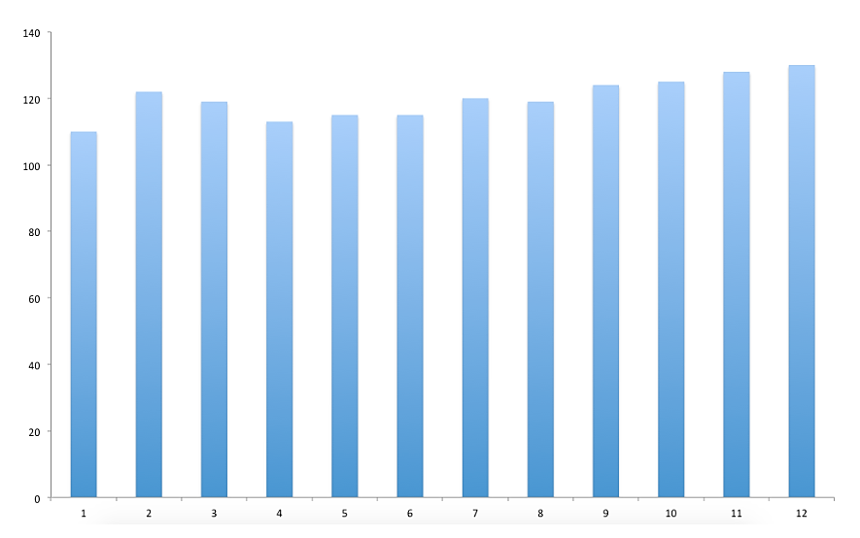
Scale Change

Slide 24
Practical Examples
False Perspective
In 2008, Steve Jobs presented Apple’s share of the smartphone market. In the chart above (which is an accurate reproduction of the one shown by Steve Jobs), we can clearly see that the slice representing Apple is larger than the one representing „others”. It also does not appear significantly smaller than RIM’s (BlackBerry) share. However, if we look at the percentage values, Apple had half the market share of RIM at that time.
At first glance, we do not notice that this is a 3D chart. It has been cleverly rotated to make it look more vertical. The effect is further intensified by changing the font size: a smaller font is used for the less significant shares, while the same size font is used for RIM, Apple, and „others”.
See the next slide

Slide 25
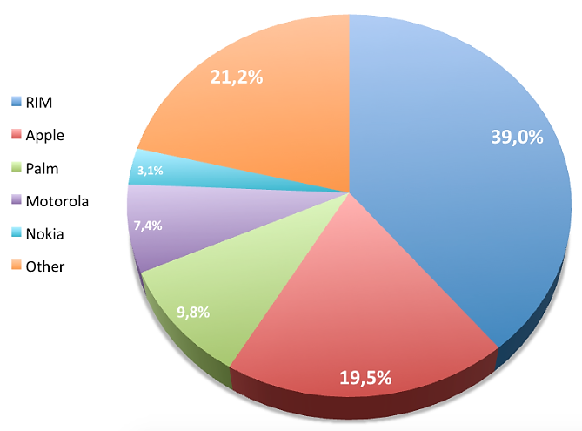
False Perspective
ICAN. (n.d.). A short guide to manipulation in data visualizations. Retrieved May 17, 2026, from https://www.ican.pl/b/krotki-przewodnik-po-manipulacji-wizualizacjami-danych/16IwGIn0h

Slide 26
Practical Examples
Clever Grouping
The charts present taxes in the United States. In the chart on the left, we can see the income (in absolute numbers) of particular groups depending on earnings.
The subtle manipulation here lies in grouping the results into different categories so that the chart takes on the shape we want. In this way, a chart that is close to a normal distribution (on the left) can be turned into a “hockey stick” chart (on the right).

Slide 27
Practical Examples
Clever Grouping
When we look at the chart on the left, we come to the conclusion that middle-class people possess the most money. In the chart on the right, several categories have been combined into one larger group.
As a result, we may conclude that the upper class (from 200 thousand dollars upward) has the most money. The same data can lead to completely different conclusions and, consequently, to different civic decisions, including decisions made in elections.
See the next slide

Slide 28
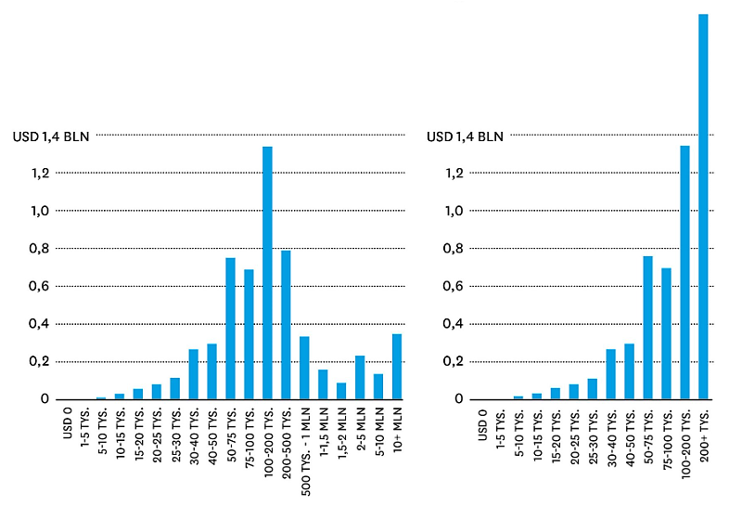
Clever Grouping
ICAN. (n.d.). A short guide to manipulation in data visualizations. Retrieved May 17, 2026, from https://www.ican.pl/b/krotki-przewodnik-po-manipulacji-wizualizacjami-danych/16IwGIn0h

Slide 29
04
Your Detective Toolkit
(20 Min)

Slide 30
Artificial intelligence can produce convincing fake media, so you need a structured approach to decide whether something is genuine.

Slide 31
Checklist to Guide your Thinking
These points are not foolproof; rather, they help you slow down and look more closely before you share or believe what you see.
Check the details: Look at the small things: does the person have the right number of fingers? Do backgrounds or reflections appear distorted? Does the lighting seem natural? Deepfakes often get these details wrong.
Check the source: Ask yourself: who posted or shared this? Is it from a news outlet or a trustworthy individual, or is it an unknown account? Try to verify whether reputable sources are reporting the same story.
Check your gut: Pay attention to how the content makes you feel. Is it designed to shock, anger or provoke? If something seems too sensational to be true, pause and investigate before reacting.
Use this checklist whenever you come across surprising content. Remember that even experts sometimes struggle to tell real from fake, and it is always better to double‑check than to spread misinformation.

Slide 32
Check the Details
AI-generated videos and images can look convincing, but small inconsistencies often give them away. This first clue focuses on noticing what seems “off” before you even know why.
Your first detective skill: slow down and look closer. Deepfakes often miss the details that real life never gets wrong.
AI can mimic faces, voices and gestures, but it still struggles with fine details. These glitches can be subtle: a strange reflection in glasses, an extra finger, shadows that don’t match or earrings that change sides between frames. Learning to notice these is the first step to developing your digital intuition.

Slide 33
Check the Source
Look for the original uploader or the website hosting it.
Check if trustworthy news outlets or official accounts are reporting the same story.
Use a reverse image search to see if the picture appears elsewhere under a different context.
Remember, the first source you see is rarely the most reliable.

Slide 34
Check the Source
Even the most realistic image or video can be misleading if it comes from an unreliable source. This second clue focuses on where a piece of content originated and how to verify it.
It’s easy to forget that every post, image or video has a creator: someone who chose to share it. A deepfake or misleading image might be uploaded by a fake account or reshared by someone who never checked it themselves. Good detectives trace the trail.

Slide 35
Check the Gut
You don’t have to know immediately whether something is real, but you can always question how it makes you feel.
Sometimes the best tool you have is your own instinct. This final clue helps learners recognise when emotions are being manipulated: a key skill for digital resilience.
If something feels too perfect, too shocking or too emotional, it might be designed to make you react before you think.
AI-generated content often plays on our emotions. It might make you angry, inspired or afraid: emotion makes people click, share and believe.
AI-generated content often plays on our emotions. It might make you angry, inspired or afraid: emotion makes people click, share and believe.

Slide 36
Check the Gut
Note what you’ve learned about slowing down emotional responses before sharing.
When something sparks a strong reaction, pause. Critical thinking isn’t about cynicism, it’s about curiosity. You don’t have to know immediately whether something is real, but you can always question how it makes you feel.

Slide 37
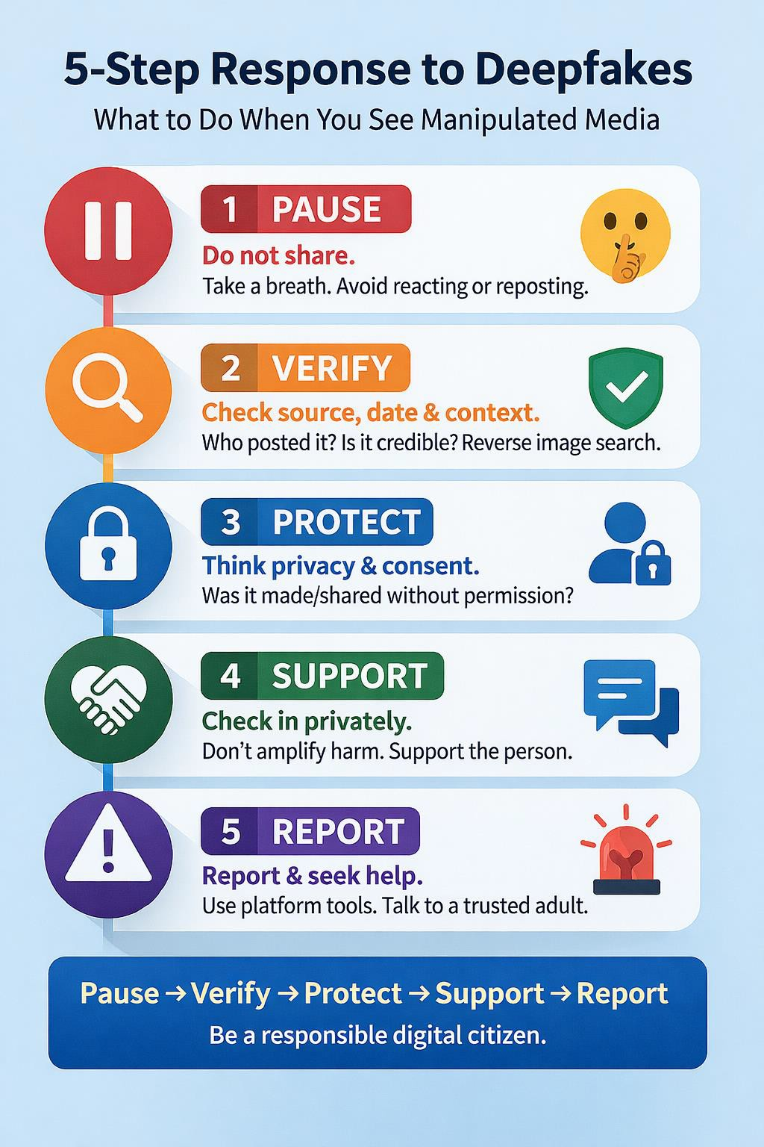
Considering Sharing Content Online?
5 Step Response to Deepfakes
What to Do When You See Manipulated Media
Check out these 5 steps to protecting yourself and others online first!

Slide 38
Why we must use Critical Thinking online?
Even short exposure to false content can shape belief
(Pennycook & Rand, 2019)
Emotional content
spreads faster than
factual corrections
(Vosoughi et al., 2018)
Debunking alone does
not erase emotional impact
(Nyhan & Reifler, 2010)
Research shows that...

Slide 39
Fact-checking Tools &Methods
Reverse image search – searching an image in reverse to identify its original source, earlier uses, and whether it has been taken out of context.
Checking metadata – examining hidden file data such as creation date, device, location, or author, if available.
Comparing with official channels – cross-checking content against statements from institutions, organizations, verified accounts, or source websites.
Fact-checking portals – using fact-checking websites that verify the accuracy of claims, images, and videos.

Slide 40
Fact-checking Tools &Methods
Checking primary sources – tracing the information back to the original source instead of relying on reposts, quotes, or summaries.
Verifying publication date and place – checking when and where the material was published and whether it matches the described event.
Context analysis – examining the full communicative context to detect quotes, images, or videos that were removed from their original meaning.
Visual geolocation – comparing elements in a photo or video with maps, buildings, signs, landscapes, or weather conditions to determine where it was taken.

Slide 41
05
Content Creator Responsibility and the Consequences of Disinformation
(15 Min)

Slide 42
Content Creator Responsibility
Do not publish unverified material – before sharing anything, check whether the information is true and confirmed by several reliable sources.
Do not share content whose authenticity you do not know – if you are not sure the material is genuine, do not amplify it.
Label synthetic content – clearly disclose when an image, audio, text, or video has been created or modified by AI.
Correct mistakes – if you notice an error in published content, correct it as quickly and visibly as possible.
Remove or correct misleading material – if content may falsely suggest facts that never happened, it should be removed or clarified.

Slide 43
Content Creator Responsibility
Do not use someone’s image or voice without consent – using another person’s face, voice, or speaking style without permission may violate privacy and personal rights.
Provide sources and context – explain where the material came from, when it was created, and why it was published.
Do not deliberately manipulate the audience – creators should avoid actions that knowingly mislead the public for gain, reach, or emotional impact.

Slide 44
Impact of misleading AI
Fake or misleading AI-generated content does not stop with one person.
When a fake image, video, or story is shared it spreads quickly across platforms, it reaches people who trust the sender, and it can cause harm far beyond the original post.
“Researchers describe this as a ripple effect, one piece of misinformation can affect trust, behaviour, and decisions at a large scale”
(Wardle & Derakhshan, 2017).

Slide 45
Types of Harm
AI-generated fakes can cause
Personal Harm: damage to someone’s reputation or mental health
Social Harm: fear, conflict, or discrimination
Democratic Harm: misleading voters or undermining trust in institutions
Safety Harm: scams, fraud, or false medical information

Slide 46
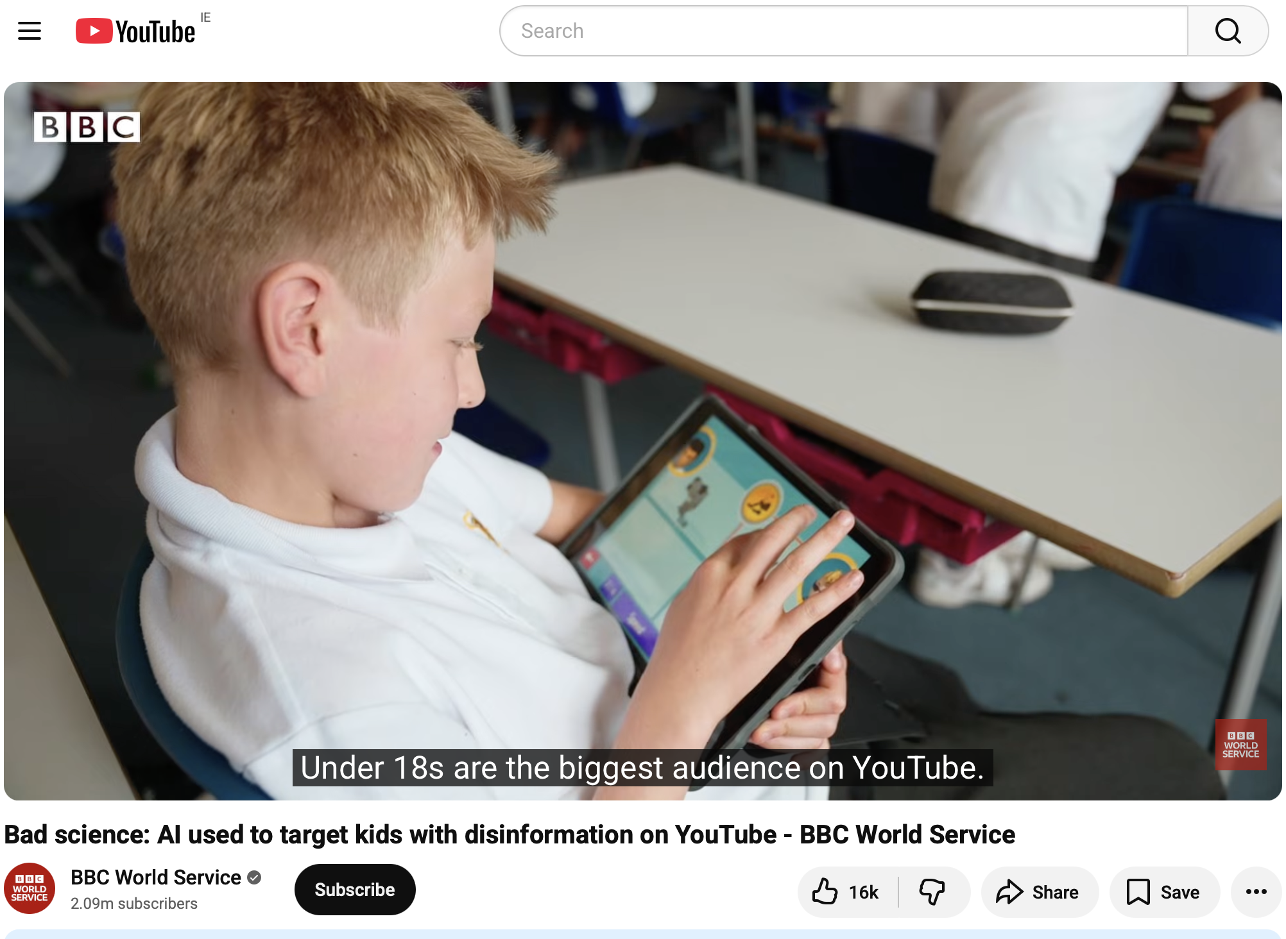
Types of Harm
Even if sharing feels harmless, the impact often is not. Watch “Bad science: AI used to target kids with disinformation on YouTube - BBC World Service”
CLICK TO VIEW

Slide 47
06
Exercises and examples
(25 Min)

Slide 48
Exercise: Role Play – The Deep Fake Dilemma
Scenario 01
A deepfake of a classmate is shared on social media as a joke — what should friends do?
Scenario 02
A popular online influencer posts a video with their partner — later, it’s revealed the
partner doesn’t exist and was created entirely with AI to boost views. Fans feel betrayed.

Slide 49
Exercise: Role Play – The Deep Fake Dilemma
Scenario 03
After a messy breakup, someone shares a video online that appears to show their ex saying cruel things or admitting to cheating. The clip spreads quickly — but it’s actually an AI-generated deepfake.
Scenario 04
You discover someone used AI to imitate your voice in a prank video —
How do you handle it?

Slide 50
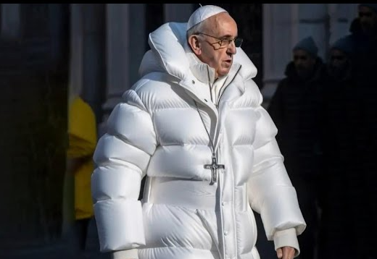
”Pope in a puffer”
Fake photos of Pope Francis in a puffer jacket go viral, highlighting the power and peril of AI
CBS News

Slide 51
”Pope in a puffer”
What happened: An AI image of Pope Francis in a white puffer jacket went viral; many thought it was real.
What misleads: Photorealism, fashion trend cues.
Intent: Playful.
Harm: Erodes trust, normalises not checking sources.
Which tiny clues could you check in this image before sharing?

Slide 52
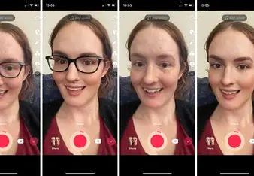
TikTok “Bold Glamour” filter
Tiktok's Bold Glamour beauty filter worries AI experts about reality
The Washington Post

Slide 53
TikTok “Bold Glamour” filter
What happened: A hyper-real beauty filter uses ML to reshape faces live.
What misleads: Seamless AI face edits feel “natural.”
Intent: Entertainment/engagement.
Harm: Unrealistic standards, body-image pressure.
How could this filter affect how people see themselves and others?

Slide 54
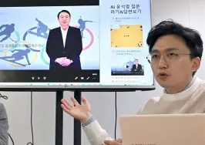
“Deepfake CFO on a Zoom”
Company worker in Hong Kong pays out £20m in deepfake video call scam
Hong Kong | The Guardian

Slide 55
“Deepfake CFO on a Zoom”
What happened: A finance worker in Hong Kong was duped by a multi-person deepfake video call of “colleagues,” sending ~ $25m.
What misleads: Convincing video and voice clones of known staff.
Intent: Fraud.
Harm: Major financial loss, reputational and legal risk.
Name two out-of-band checks you would require before any transfer.

Slide 56
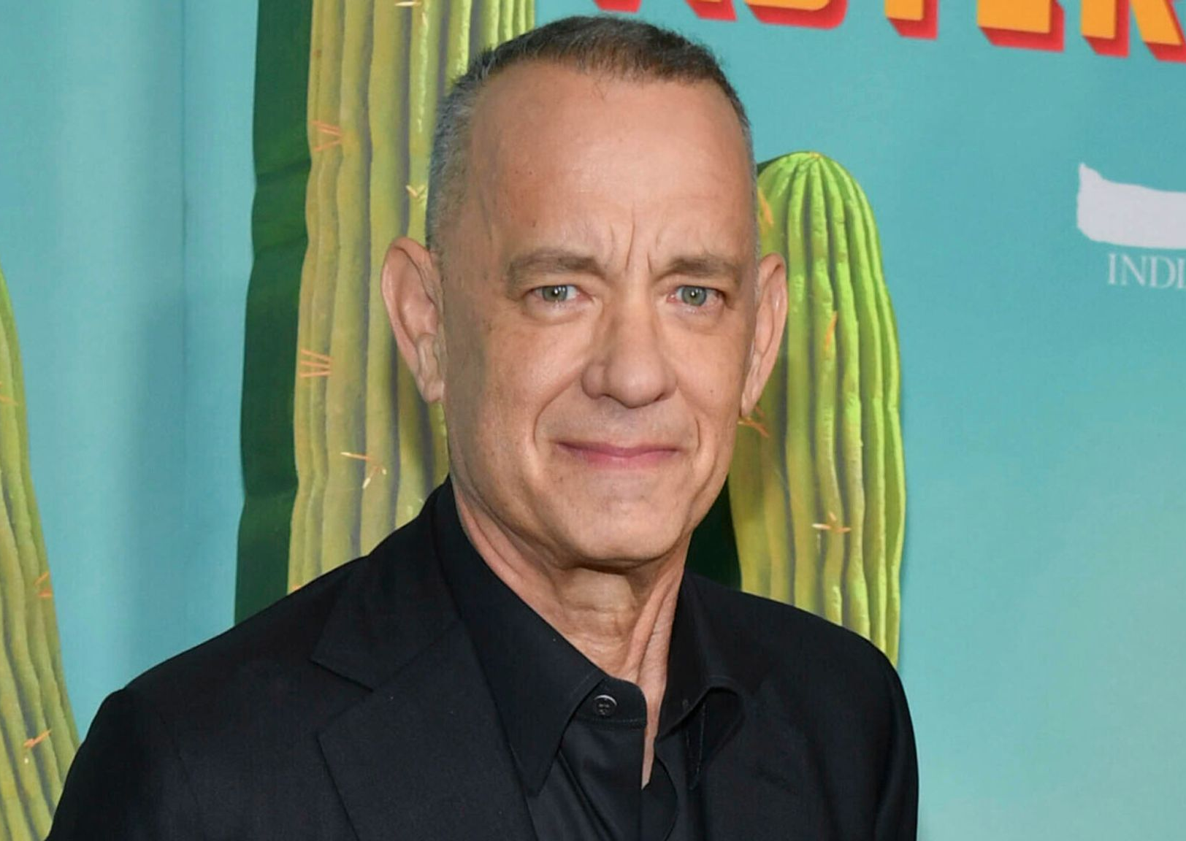
“That ad isn’t me”
Tom Hanks warns fans not to fall for deepfake advert using his face
Ents & Arts News | Sky News

Slide 57
“That ad isn’t me”
What happened: An AI video used Tom Hanks’ likeness to sell a product; he warned fans.
What misleads: Trusted face and voice, ad format.
Intent: Commercial deception.
Harm: Consumer fraud, misuse of image rights.
How would you verify a celebrity endorsement before you believe it?

Slide 58
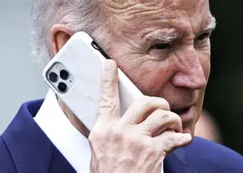
“Don’t vote today”
Political consultant behind AI-generated Biden robocalls faces $6 million fine, criminal charges
AP News

Slide 59
“Don’t vote today”
What happened: An AI voice mimicking President Biden told voters to skip the primary; fines and charges followed.
What misleads: Familiar political voice, timed before voting.
Intent: Voter suppression.
Harm: Interferes with democratic participation.
What should a voter do on
receiving a call like this?

Slide 60
Exercise: Role Play – The Deep Fake Dilemma
Divide into 3–4 small groups.
Each group will act out one scenario.
Performance no more than
2–3 minutes each.
Group reflection.

Slide 61
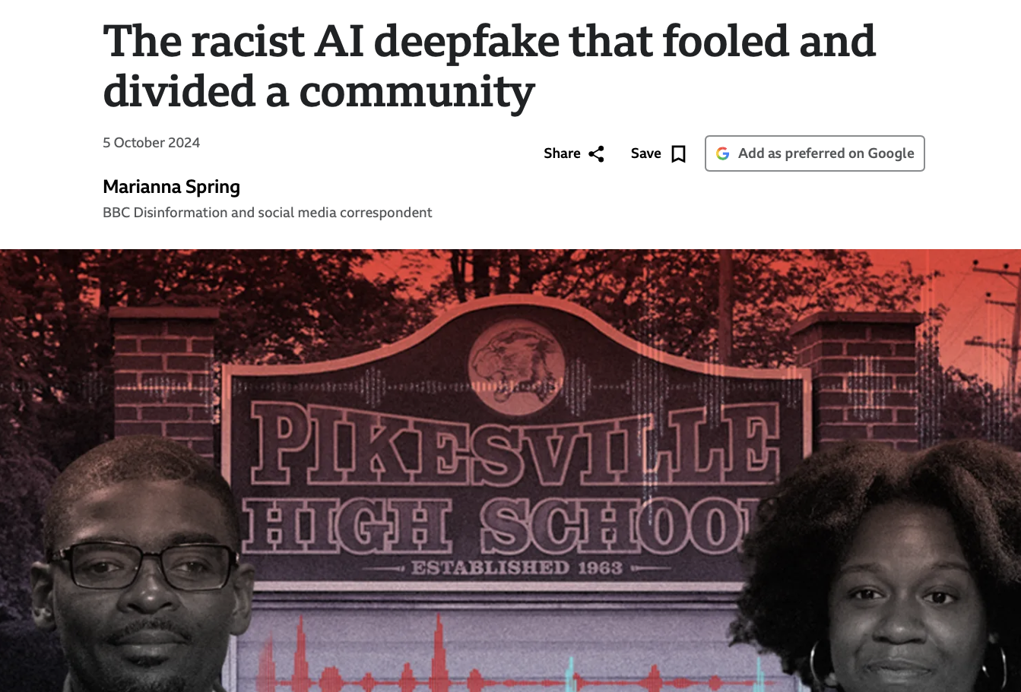
Case Study “The Fake Audio
That Divided a Community”
CLICK TO VIEW
In a town near Baltimore (USA), an audio clip appeared online that sounded like a school principal making racist and antisemitic comments.
The clip spread quickly on social media.
Many people believed it was real.
Parents were angry.
The school received threats.

Slide 62
Case Study “The Fake Audio
That Divided a Community”
CLICK TO VIEW
The principal was placed on leave while investigations began.
Later, police confirmed the audio was AI-generated and fake. But even after this was proven, the damage remained, trust in the school was broken, people still felt hurt and angry, some continued to believe the clip reflected “how people really think”.

Slide 63
Case Study “The Fake Audio
That Divided a Community”
CLICK TO VIEW
The principal was placed on leave while investigations began. Later, police confirmed the audio was AI-generated and fake. But even after this was proven, the damage remained, trust in the school was broken, people still felt hurt and angry, some continued to believe the clip reflected “how people really think”.

Slide 64
Case Study “The Fake Audio That Divided a Community”
Why people believed it?
Researchers explain that people believed the clip because:
It sounded authentic (voice cloning)
It included insider details (school language, staff names)
It matched existing fears and experiences
Audio-only content has fewer visual clues
Platforms amplified it before verification
This is known as authenticity bias, when something feels real, we accept it as real(Vosoughi et al., 2018; Lewandowsky et al., 2012). AI fakes don’t just trick our eyes or ears. They exploit trust, emotion, and past experience. Critical thinking is not just about spotting technical errors. It is about recognising how emotions and beliefs shape judgement.

Slide 65
Case Study “The Fake Audio That Divided a Community”
What Could Have Slowed the Harm?
Ask learners to discuss…
At which moment could the spread have slowed?
before sharing? before reacting emotionally? before platforms amplified it?
Which THINK questions matter most here?
True? (Was the source verified?)
Intent? (Who sent it and why?)
Kind? (Who could be harmed?)
Why was “it feels true” more powerful than “it is true”?

Slide 66
Evidence Snapshot, your “Detective Record’”
You have 5-8mins for this activity, on your own or in pairs;
Choose one piece of content (image, video, audio, or chatbot answer).
Create a short “Detection Note” using the template below.
Detection Note Template (fill in)
What is the content? (1 sentence)
Where did I find it? (platform/account/link if possible)
My first reaction: (what did I feel?)

Slide 67
Evidence Snapshot, your “Detective Record’”
My checks (tick what you used)
My decision
Details check (what looked off?)
Source check (who posted? any trusted sources?)
Emotion check (was I being pushed to react?)
I trust it enough to use/share
I’m unsure (I will not share yet)
I think it’s misleading / fake
One sentence why (your reasoning):
Why this matters (short theory line): (Writing your reasoning makes your thinking visible,
this is a core part of critical thinking and metacognition (thinking about how you think).

Slide 68
Follow Our Journey
l
in
f
www.valuesai.eu
Co-funded by the European Union. Views and opinions expressed are however those of the author or authors only and do not necessarily reflect those of the European Union or the Foundation for the Development of the Education System. Neither the European Union nor the entity providing the grant can be held responsible for them.

