Slide 1



www.valuesai.eu
MODULE 02
Transparency
Being Transparent with AI generated content
Co-funded by the European Union. Views and opinions expressed are however those of the author or authors only and do not necessarily reflect those of the European Union or the Foundation for the Development of the Education System. Neither the European Union nor the entity providing the grant can be held responsible for them.

Slide 2
Contents
01
What is transparency in working with AI, and why does it matter? (10 min) 3
02
AI-generated, AI-assisted and AI-edited content (15 min) 7
03
Regulations and rules for labeling AI-generated content (15 min) 11
04
AI in the context of intellectual value and authorship protection (20 min) 19
05
Creation Process (10 min) 25
06
Exercises and Activities (30 min) 29

Slide 3
01
What is transparency in working with AI, and why does it matter?
(10 min)

Slide 4


Transparency in AI-generated content means clearly informing the audience when and how artificial intelligence was used to create a text, image, analysis, or any other type of content.
The goal is to avoid misleading people about authorship, sourcing, or the degree of human involvement.

Slide 5
In practice, transparency may involve a short note stating that a section was generated or edited with the help of AI. It can also include specifying the scope of AI use, such as language polishing, drafting, data analysis, or image generation. This helps the audience understand exactly how AI contributed to the final result.
Transparency matters for several reasons. First, it builds trust — readers or viewers know whether the content is fully human-made or supported by technology.
Second, it supports accountability, because the human author remains responsible
for the accuracy, quality, and reliability of the output. Third, it is ethically important, especially in academic work, education, journalism, and public communication.

Slide 6
Exercise & Discussion
Have a short discussion on the topic: Is there a need to inform every time AI is involved in any aspect of the creative process?
Try to consider whether the same applies in situations where AI takes part in the decision-making or evaluation process.
AI creates based on the data provided to it, but doesn’t humans also create through imitation? For example, a painter who admires nature and seeks inspiration from it?

Slide 7
02
AI-generated, AI-assisted and AI-edited content
(10 min)

Slide 8
AI-Generated Content
Content generated by AI is material in which artificial intelligence creates most or all of the output independently, based on a user prompt or instructions. Human involvement is usually limited to providing the topic or basic guidance
⁰¹
AI-Assisted Content
Content assisted by AI is created mainly by a human, while AI helps with specific parts of the process, such as brainstorming, style improvement, summarization, translation, or structuring the text.
⁰²
AI-Edited Content
Content edited by AI is material originally written by a human and then refined by AI in terms of language, style, grammar, clarity, or coherence.
⁰³

Slide 9
Term.
Who is the.
main Author?.
Role of AI .
Example .
AI-Generated Content | AI | AI creates the content almost independently | A user enters a prompt & AI writes the full article
AI-Assisted Content | Human | AI supports the creation process | The author writes the text & AI helps improve wording
AI-Edited Content | Human | AI edits an already written text | A human-written article is corrected by AI for grammar

Slide 10
Exercise
Determine the type of AI involvement:
AI-generated, AI-assisted or AI-edited content
AI Tasks
Generating an article that was then modified and improved by a human
Alphabetically organizing the table of contents in an article
Preparing a LinkedIn post
Removing the background from a photo
Generating slogans for a presentation prepared by a manager
Transcribing video content
Preparing an email to a client

Slide 11
03
Regulations and rules for labeling AI-generated content
(15 min)

Slide 12
AI Act
AI Act is a European Union regulation that establishes harmonized rules for artificial intelligence systems in the EU. Its purpose is to ensure safety, the protection of fundamental rights, and transparency, while also supporting innovation.
AI Act
Regulation (EU) 2024/1689 of the European Parliament and of the Council of 13 June 2024 laying down harmonized rules on artificial intelligence. AI Act entered into force: 1 August 2024, 20 days after publication in the Official Journal of the EU on 12 July 2024. The first provisions began to apply gradually from 2 February 2025, with additional obligations following in later phases.
The Act Texts - Click to read

Slide 13
The rules for labeling content created using AI are set out in Article 50 of the AI Act

Slide 14
Art. 50 § 1
Providers shall ensure that AI systems intended to interact directly with natural persons are designed and developed in such a way that the natural persons concerned are informed that they are interacting with an AI system, unless this is obvious from the point of view of a natural person who is reasonably well-informed, observant and circumspect, taking into account the circumstances and the context of use.

Slide 15
Art. 50 § 2
Providers of AI systems, including general-purpose AI systems, generating synthetic audio, image, video or text content, shall ensure that the outputs of the AI system are marked in a machine-readable format and detectable as artificially generated or manipulated.

Slide 16
Art. 50 § 3
Deployers of an emotion recognition system or a biometric categorisation system shall inform the natural persons exposed thereto of the operation of the system, and shall process the personal data in accordance with applicable Union law.

Slide 17
Art. 50 § 4
Deployers of an AI system that generates or manipulates image, audio or video content constituting a deep fake, shall disclose that the content has been artificially generated or manipulated. Deployers of an AI system that generates or manipulates text which is published with the purpose of informing the public on matters of public interest shall disclose that the text has been artificially generated or manipulated, subject to the stated exceptions.

Slide 18
Interpretation
If AI only helped with proofreading, formatting, or organizing the content, this usually does not fall within the core labeling requirement under the AI Act.
However, if AI generated content, an image, a voice recording, or a video that the recipient may perceive as authentic, labeling is generally required.
Practical Rule
If in doubt, follow this rule: it is better to disclose than to conceal. This is especially important in education, publishing, marketing, media, and anywhere content may influence other people’s decisions.
The Act Texts - Click to read

Slide 19
04
AI in the context of intellectual value and authorship protection
(20 min)

Slide 20


AI today occupies the role of a tool that supports creativity and the protection of intellectual property, but it does not replace human authorship in the legal sense.
In practice, this means that AI can help create, organize, and personalize content, while authorship, work protection, and responsibility still depend primarily on human involvement.
CLICK TO VIEW

Slide 21
Intellectual Value
AI increases the intellectual value of work mainly by speeding up creation, supporting analysis, generating variants, and helping produce more refined content.
Its role is therefore usually instrumental:
it helps a person move more quickly from an idea to a finished piece.

Slide 22
Authorship & Protection
Many studies emphasize that content created autonomously by AI usually does not meet the classic requirements of a copyrighted work, because there is no human author.
On the other hand, if a person clearly shapes the result, for example through selection, editing, and repeated refinement of prompts, an area of co-creation emerges that is still legally ambiguous.

Slide 23
Securing Authorship
The most important way to secure authorship is to demonstrate one’s own creative contribution: concept, selection, editing, interpretation, and the final decision about the shape of the text.
In practice, it is also worth documenting the work process, because that makes it easier to show that AI was a supporting tool rather than the sole creator.

Slide 24
Role of AI
The most accurate way to put it is that AI sits between a tool and a functional co-author: it is very important in the creative process, but it does not fully take over legal authorship.
Therefore, in academic, business, and publishing contexts, AI should be treated as support rather than as an independent source of legal protection.

Slide 25
05
Creation Process
(10 min)

Slide 26
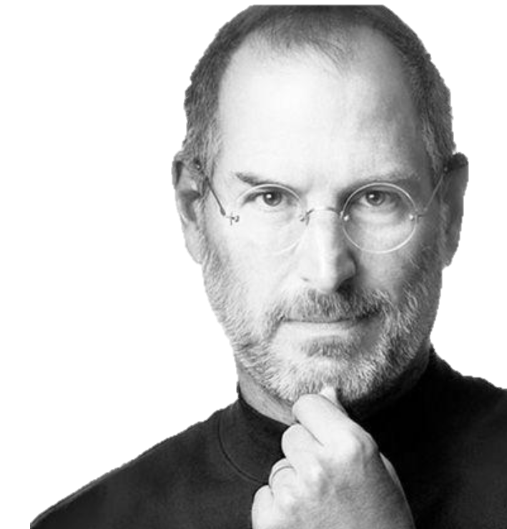
What responsible creation looks like
Don’t trick people. Don’t make something look real if it isn’t, or let people think AI-made content is a real photo, real quote or real evidence.
Don’t copy and paste as if it’s yours. AI can help you draft, but you should rewrite in your own words and give credit if you use someone else’s ideas or work.
Don’t use other people’s personal info. Don’t put names, phone numbers, private messages, photos or anything personal into an AI tool without permission.
Don’t make content that targets someone. Don’t use AI to embarrass, bully, stereotype or “joke” about a person or group.
Don’t believe it just because it sounds confident. AI can be wrong. Always check facts before you share.
When you use AI to help you make something, here’s what to avoid:
“Creativity is just connecting things.”
Steve Jobs

Slide 27
The Creation Workflow
01
02
03
04
Create
Verify
Fairness Check
Disclose
What are you making
and who is it for?
Is it true and is it real? Don’t trust it just because it sounds confident.
Who is included, who
is left out and could this hurt someone
or feel unfair?
If AI helped, say so
in a simple way. Don’t make people think it’s something it isn’t.
A simple creation routine
(use this every time you make something with AI)

Slide 28
What good practice looks like
When you use AI to help you create something, aim for this:
Know your purpose and who it’s for. What are you trying to say and who will see it?
Keep your prompts clean. Use general information, not personal details about real people.
Check before you share. If it includes facts, names, quotes or “proof”, verify it first.
Make it fair and inclusive. Watch for stereotypes and make sure different people are represented respectfully.
Be clear when AI helped. A simple line like „Drafted with AI and edited by me/us” can be enough when it matters.

Slide 29
06
Exercises and Activities
(30 min)

Slide 30
THE “OPEN BOX” CHALLENGE
Make 3 Groups
Goal
Understand why we need to know how AI makes decisions.
Task
Your group is an “AI Audit Team.”
Situation
A company uses a “Black Box” AI (no one knows how it works) to make life-changing decisions.
Your Job
Look at the AI's decision, identify why it might be unfair, and list 3 things the company must explain to the public to be „transparent.”

Slide 31
Group 1
The Job Interview AI
Scenario
A big tech company uses AI to scan CVs. The AI automatically rejects anyone who didn't play "team sports" in high school.
Task
Why is this rule hidden in a "Black Box" dangerous?
Who might be unfairly treated by this rule?
Transparency
Write down 2 things the company should tell applicants about how the AI ranks them.
Action

Slide 32
Group 2
The Medical Diagnosis AI
Scenario
A hospital uses AI to decide which patients get a surgery room first. The AI starts giving priority to people who live closer to the hospital
Task
Is “distance from hospital” a fair way to decide on surgery? Why or why not? What happens if the doctors don't know the AI is using „distance” as a rule?
Transparency
List 2 rules the AI should use and show to the patients.
Action

Slide 33
Group 3
The Social Media “Truth” AI
Scenario
A social media app uses AI to hide posts it thinks are
“boring” or "low quality.” Suddenly, posts about local
news are disappearing.
Task
Why is it a problem if users don't know how the “Quality Filter” works? How does this affect what people learn
about the world?
Transparency
Create a “Public Disclosure Rule.” List 3 things the app must tell the community about how it chooses which news posts to show and which to hide.
Action

Slide 34
Practical Exercise:
Designing Effective AI Content Labelsfacing a moral dilemma
The Challenge
Transparency requires clear, informative labeling of AI-generated content. But what information should these labels contain? How can we be transparent without overwhelming readers?
⁰¹
Your Task
Design a concise label for a blog post, social media image, or video that was created with AI assistance. Your label should inform readers while maintaining readability and professionalism
⁰²
Essential Elements to Consider
AI tool or platform used:
Date of generation
Human author or reviewer
Nature of AI involvement (full generation vs. Assistance)
Verification or fact-checking performed sources consulted
⁰³

Slide 35
Practical Exercise: Designing Effective AI Content
Labelsfacing a moral dilemma. Example Labels
Comprehensive Disclosure
Concise
Version
Visual
Content
“This article includes AI-generated content created using GPT-4 on March 15, 2024. All information has been fact-checked and verified by the author, Dr. Sarah Mitchell. Sources include peer-reviewed research and industry reports cited throughout.
“AI-assisted content (GPT-4) - Verified by author - March 2024”
“Image generated by
Midjourney AI - Prompt
by Design Team – Human
-selected from 20+ variations”
Discussion Points. What level of detail is appropriate for different contexts?
Should social media posts require the same disclosure depth as educational materials?
How can organizations standardize their AI labeling practices?

Slide 36
Tool in action: one-minute example (before and after)
Scenario: You are making a quick post to promote a youth event
BEFORE (AI draft)
Run the routine (quick talk track)
“Join us for an amazing Youth Night this Friday. Everyone is welcome! We’ll have fun games, prizes and free food. Don’t miss out – it’s going
to be the best night ever!”

Slide 37
Tool in action: one-minute example (before and after)
BEFORE (AI draft)
Scenario:
You are making a quick post to promote a youth event
Run the routine (quick talk track)
“Join us for an amazing Youth Night this Friday. Everyone is welcome! We’ll have fun games, prizes and free food. Don’t miss out – it’s going to be the best night ever!”

Slide 38
Tool in action: one-minute example (before and after)
BEFORE (AI draft)
Scenario:
You are making a quick post to promote a youth event
Create: Who is it for? What do people actually need to know?
Check it: Are there prizes and free food? Is “everyone” true (age limits, booking)?
Fairness check: Does it sound welcoming to everyone or does it feel like it’s only for confident/extroverted people?
Be clear: Did AI help write this? If yes, add a simple line if needed (especially in a school/youth setting).

Slide 39
Tool in action: one-minute example (before and after)
AFTER (Improved Version)
Scenario:
You are making a quick post to promote a youth event
“Youth Night – Friday 6–8pm at the Youth Centre.
Ages 13–17. Free entry. Games and music, with snacks available. If it’s your first time, you can come with a friend or just drop in and say hi to a leader at the door. If you need any access support, message us privately.”
It’s clearer, more accurate, more welcoming and it doesn’t promise things that might not be true.

Slide 40
Main activity: Create, then improve
You’ll work in pairs or small groups to make a short piece of content with AI support
(for example a post, a message or a short script). Then you’ll run the routine on it:
Create
Check It
Fairness Check
Be Clear
As you do it, you must keep a quick record of what you changed and why,
including which tools you used (for example the THINK routine,
the fairness check or the verification step) and how they helped
you make the content safer, fairer and more accurate.

Slide 41
Choose One Creation Task
(we’ll do one today, the others are extra)
Pick one of these to create with AI, then improve using the routine
Youth event post: Write an Instagram-style caption and a short description of the image you would use.
Apology or repair message: Draft a short message to fix a situation where something you said or shared caused harm (even if you didn’t mean it).
Poster or flyer: Create text for a poster, then check it for fairness and add a simple AI disclosure if needed.
Short explainer: Write a short explanation of how a claim can spread online, and include one quick step for checking if it’s true.

Slide 42
Group Decision Log
(fill this in as you work)
Use this quick checklist to record what you did and why
Purpose and audience: What are you making and who is it for?
Two risks noticed: What could go wrong if this is shared? (misleading, unfair, private, harmful, etc.)
What you checked: What did you verify and how did you check it?
Fairness check: What did you change to make it more inclusive or less unfair?
Disclosure line: What simple line would you add to be clear if AI helped?

Slide 43
Share Back & Compare
Each group shares one improvement you made after you checked facts or did the fairness check. Explain your thinking in one or two sentences: What did you change and why?
We are not looking for one “perfect” answer. The goal is to hear different approaches, learn from each other and notice how small changes can make content more accurate, fair and safe to share.

Slide 44
Follow Our Journey
l
in
f
www.valuesai.eu
Co-funded by the European Union. Views and opinions expressed are however those of the author or authors only and do not necessarily reflect those of the European Union or the Foundation for the Development of the Education System. Neither the European Union nor the entity providing the grant can be held responsible for them.

