Slide 1



www.valuesai.eu
MODULE 01
Fairness & Bias in AI
Ensuring Balanced Representation & Viewpoints
Co-funded by the European Union. Views and opinions expressed are however those of the author or authors only and do not necessarily reflect those of the European Union or the Foundation for the Development of the Education System. Neither the European Union nor the entity providing the grant can be held responsible for them.

Slide 2
Contents
01
Introduction and important facts about AI (10 min) 3
02
What is fairness and bias in AI and why does it matter? (10 min) 8
03
How to use AI the right way? Five rules (15 min) 11
04
Sources of bias in AI (20 min) 25
05
How to avoid bias? (10 min) 40
06
Examples, Exercises, Data, & Advices (20 Min) 45

Slide 3
01
Introduction & important facts about AI
(10 min)

Slide 4

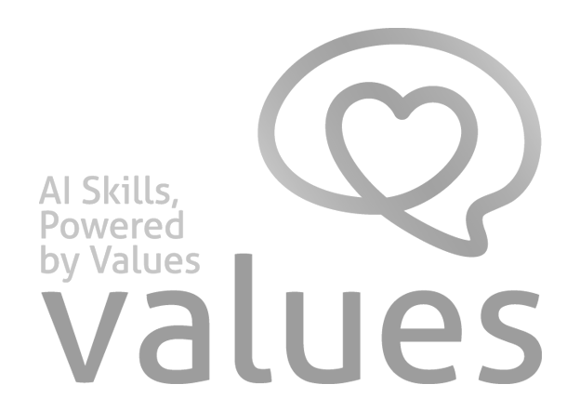
Artificial intelligence is widely used to create digital content such as texts, images, and videos.
This content influences how people think and make decisions. For this reason, it is important to understand how AI is used and how to ensure fairness and responsibility in AI-generated content

Slide 5

FACT 1
“People may think they can trust what they’re reading from these AI assistants, but this research shows they can produce responses to questions about key news events that are distorted, factually incorrect or misleading.”
Pete Archer, Programme Director
for Generative AI at the BBC 11 February 2025
Artificial intelligence is not infallible. It relies on data without verifying its accuracy, which can lead to incorrect conclusions.

Slide 6

FACT 2
“ What we teach AI reveals our own values.”
”We need to make sure AI systems
are aligned with human values..”
Demis Hassabis
CEO Google DeepMind
Artificial intelligence is artificial. It is based on algorithms developed by humans. These algorithms differ in sensitivity, accuracy, quality, and other parameters that have a significant impact on the feedback they produce.

Slide 7
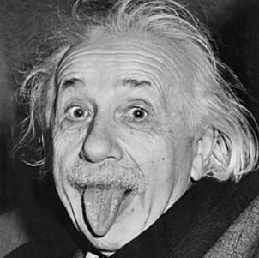
FACT 3
“ If I had an hour to solve a problem and my life depended on the solution, I would spend the first 55 minutes determining the proper question to ask; for once I know the proper question, I could solve the problem in less than five minutes.”
Albert Einstein
Pay attention to how you formulate your questions.
A great deal depends on the precision of your wording and your level of existing knowledge.

Slide 8
02
What is fairness and bias in AI and why does it matter?
(10 min)

Slide 9
What is Bias?
Bias in AI can arise at many stages: from data collection, through model design, to implementation.
Bias means being unfair or favoring some people over others.
In AI, bias happens when the system is trained on limited or unbalanced data and repeats those patterns.
In AI, bias can look like:
  Some people are shown more often than others
  Some groups are left out
  Stereotypes are repeated
Why bias matters:
  AI can affect many people at once
  Unfair results can cause real harm
  People must check and correct AI outputs

Slide 10
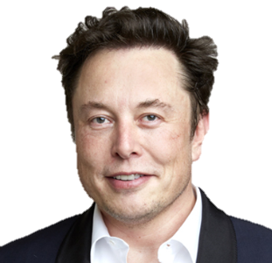
Why Fairness Matters?
Fair treatment of individuals and groups
Avoiding bias and discrimination
Equal representation and inclusion
Human responsibility for fair AI use
“AI will be the best or worst
thing ever for humanity.”
Elon Musk

Slide 11
03
How to use AI the right way? Five rules
(15 min)

Slide 12
The 5 Rules of using AI the right way
⁰¹
Use Good & Fair Data
⁰⁵
Check the Results Often
⁰²
Check for Unfair Patterns
⁰⁴
Keep People Involved
⁰³
Explain how it Works

Slide 13
Rule 01
AI learns from the information we give it. If the information is missing some groups of people, the AI will not work well for everyone. To be fair, we must use data that represents everyone equally.
The global amount of data on the Internet currently amounts to about 200 zettabytes (ZB) and is increasing exponentially.
One zettabyte is one trillion gigabytes (GB).
1 ZB = 1,000,000,000,000 GB
However, not all of this information is true, current, or reliable.

Slide 14
Use verified data.
If a piece of information is especially important to you, it is worth checking it at the source.
Remember: regardless of where the data comes from, always subject it to your own critical evaluation.
Stay alert to signs of discrimination and unequal treatment.

Slide 15
Examples of reliable sources of data and information
Official government websites or recognized international institutions.
Thematic reports prepared by reputable institutions, such as the United Nations and its specialized agencies, including the UN, UNESCO, FAO, and ILO.
Databases with official statistical data maintained by recognized organizations, such as Eurostat — the official statistical database of the European Union.
Recognized databases with scientific publications such as Scopus, Web of Science, PubMed, and ScienceDirect.

Slide 16
Rule 02
Before we start using an AI tool, we need to test it. We must look for „bias” - which is when the AI treats one group of people better than another. If we find a problem, we must fix it immediately.
Testing tools and systems for bias means checking whether their outputs are systematically skewed in favor of or against certain groups, topics, or scenarios.
In other words, it is about detecting unfairness in the data, the model, the rules it follows, or the way it is used.

Slide 17
How does such testing look in practice?
Comparing the system’s responses for different user groups or profiles
Checking whether the model favors one gender, nationality, age group, language,
or social status
Analyzing training data for lack of representativeness
Testing with controlled sets of similar questions where only sensitive attributes are changed
Assessing whether the system reproduces stereotypes or generates unfair recommendations

Slide 18
Rule 03
To obtain correct results from AI, you need to understand how the system is built, what it relies on, and what its limitations are.
AI works on the basis of data, patterns, instructions, and optimization rules, so the quality of its answers depends on the quality of the input, the context, and the way the system is used.

Slide 19
Key Principles
Provide context, purpose, and audience.
Use specific input instead of vague wording.
Check whether the answer is consistent with trusted sources.
Remember that AI does not “know” in a human sense; it processes patterns from data and instructions.

Slide 20

Rule 04
“ We must ensure
AI remains under
human control”
Professor at the Université de Montréal AI systems specialist
and researcher
We should not let AI make all the big decisions. Humans should always supervise the AI.
A person should have the final say, especially in important things like jobs or health, to make sure the AI is being kind and fair.

Slide 21
The concept of human involvement in technological processes, especially decision-making ones, is one of the main assumptions of the EU strategy: Industry 5.0. Its aim is to direct and balance technological development in such a way that it brings the greatest benefits and supports the protection, rather than the violation, of human values.

Slide 22
CASE STUDY:
Amazon AI hiring tool
Amazon developed an AI-based recruiting system to screen job applicants, but the system learned from past hiring patterns and began downgrading resumes that included signals associated with women.
Because the problem was discovered by people reviewing the system, Amazon scrapped the tool before it was fully deployed.
This is a clear case where human oversight prevented an AI mistake from becoming an operational decision, especially in a high-stakes area like hiring.

Slide 23
Rule 05
The world changes, and AI can change too. We need to check the AI every few months to make sure it is still doing a good job. If it starts making mistakes or acting unfair, we need to update it.
Why this matters
AI does not stay perfect after deployment, because the data around it changes over time. User behavior, social conditions, business rules, and even language can shift, which can make an older model less reliable

Slide 24
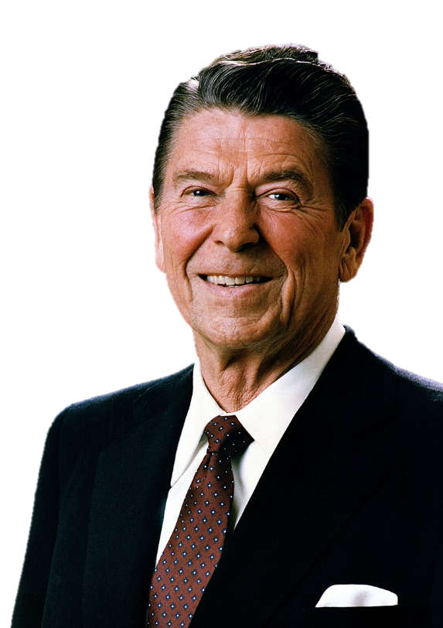
Regular reviews usually look at performance, bias, and data drift.
Teams compare current results with earlier benchmarks, check whether certain groups are treated unfairly, and decide whether the model needs retraining or adjustment.
“Trust, but verify.”
Ronald Reagan

Slide 25
04
Sources of
Bias in AI
(20 min)

Slide 26
Bias in AI Systems
Training Data Bias
Data Labeling
Bias
Bias resulting from safety filters & moderation
01
03
05
02
04
06
Selection
Bias
Bias resulting from Model Design
Bias resulting from the decisions of AI tool providers

Slide 27
Bias resulting from the version of the AI system
Interactive / Conversational Bias
Bias resulting from the omission of less popular viewpoints
07
09
11
08
10
12
Bias resulting from the way the user formulates the question
Post-Deployment Bias / Feedback Loop Bias
Linguistic & Cultural Bias

Slide 28
01
Training data bias is bias in the data used to train an AI model, meaning the dataset is unbalanced, unrepresentative, or contains prejudices, which can lead the model to learn distorted patterns.
Training Data Bias
EXAMPLE:..
An example could be a facial recognition system trained mainly on images of people with light skin. Such a model may perform worse at recognizing people with darker skin because there were too few of them in the training data.

Slide 29
02
Selection bias is a sampling error that occurs when the people or data included in an analysis are not representative of the whole population, which can distort the result.
Selection Bias
EXAMPLE:..
If you survey app service quality only among the most active users, the results may be too positive because you exclude less satisfied or less active customers.

Slide 30
03
Data labeling bias is bias that occurs when people or tools assigning labels to data do so subjectively, inconsistently, or with prejudice.
Data Labeling Bias
EXAMPLE:..
If the same images are labeled as „aggressive” by some annotators and „neutral” by others, the model learns distorted patterns.

Slide 31
04
Bias resulting from model design is bias caused by the model’s own architecture and design choices, including which features it uses and how it optimizes decisions.
Bias resulting from Model Design
EXAMPLE:..
A hiring system designed in a way that favors candidates with a specific CV style or career path similar to people already employed. As a result, it may score highly qualified candidates lower simply because their background looks less „standard.”

Slide 32
05
Bias resulting from safety filters and moderation is bias that occurs when safety filters or moderation systems too often block, soften, or flag as unsafe content from certain groups, topics, or speaking styles.
Bias resulting from safety filters and moderation
EXAMPLE:..
A chatbot may automatically reject neutral messages about sexual health or activism because the filter mistakenly treats them as risky.

Slide 33
06
Bias resulting from the decisions is bias caused by choices made by the developers, owners, or operators of an AI system that affect how it works and what it outputs.
Bias resulting from the decisions of AI tool providers
EXAMPLE:..
A company may configure a recommendation model to promote its own products or sponsored content, so users see fewer neutral results and more commercial ones.

Slide 34
07
Bias resulting from the version of the AI system is bias caused by different versions of the same system producing different answers or behaving differently, for example when the paid version uses a better model, a larger context window, or fewer limits than the free version.
Bias resulting from the version of the AI system
EXAMPLE:..
The free chatbot version may shorten answers more often or handle a complex question less well, while the paid version may respond more fully and consistently.

Slide 35
08
Bias resulting from the way the user formulates the question is bias caused by the wording of the prompt influencing the model’s answer. If the question implies one interpretation, the AI may respond in a one-sided way instead of neutrally.
Bias resulting from the way the user formulates the question
EXAMPLE:..
Asking “Why is this policy bad?” pushes the model toward a critical answer, while the more neutral „What are the pros and cons of this policy?” gives a more balanced response.

Slide 36
09
Interactive / conversational bias is bias that appears during an AI conversation when the model’s answers are shaped by earlier questions, the order of messages, the dialogue style, or the user’s responses.
Interactive / Conversational Bias
EXAMPLE:..
If a user first suggests a negative judgment about a topic and then asks for details, the model may keep reinforcing that one-sided view instead of staying neutral.

Slide 37
10
Post-deployment bias / feedback loop bias is bias that appears after a system is deployed and becomes stronger over time because the model starts learning from its own outputs or from data it helped create.
Post-Deployment Bias / Feedback Loop Bias
EXAMPLE:..
A recommendation system shows users mostly one type of content, so they click it more often, and the model treats that as the „best choice” and promotes it even more.

Slide 38
11
Bias resulting from the omission of less popular viewpoints is bias in which an AI system leaves out less popular, minority, or less „clickable” perspectives, making the picture of the topic incomplete.
Bias resulting from the omission of less popular viewpoints
EXAMPLE:..
When a user asks about a controversial reform, the AI may present mainly the dominant majority view and omit arguments from experts or minority groups that are less represented in the data or less popular online.

Slide 39
12
Linguistic and cultural bias is bias that occurs when an AI system understands and handles some languages, dialects, or cultural patterns better than others.
Linguistic & Cultural Bias
EXAMPLE:..
A model may work well in American English but struggle with a local dialect or automatically „correct” British spelling to American spelling, leading to less accurate responses for users from another cultural background.

Slide 40
05
How to avoid bias?
(10 min)

Slide 41
Bias Type. | Best Practice to Reduce it.
Training data bias | Use diverse, representative data and review dataset composition regularly.
Selection bias | Ensure random or well-justified sampling so important groups are not excluded.
Data labeling bias | Use clear annotation guidelines and inter-annotator consistency checks.
Bias resulting from model design | Test the model across different groups and compare fairness metrics before deployment.
Bias resulting from safety filters and moderation | Evaluate filters on examples from different groups and topics to avoid over-blocking.

Slide 42
Bias Type. | Best Practice to Reduce it.
Bias resulting from the decisions | Document design choices and justify the model’s operating rules.
Bias resulting from the version of the AI system | Compare versions on the same test set and do not mix results from different versions without analysis.
Bias resulting from the way the user formulates the question | Ask neutral, precise questions that do not suggest the answer.
Interactive / Conversational Bias | Keep the context consistent and start a new thread when the topic changes.

Slide 43
Bias Type. | Best Practice to Reduce it.
Post-deployment Bias / Feedback Loop Bias | Monitor post-launch outputs and periodically retrain on fresh external data.
Bias resulting from the omission of less popular viewpoints | Intentionally include sources from multiple perspectives, including less popular ones.
Linguistic & Cultural Bias | Test the system in multiple languages and cultural variants, not just the dominant one.

Slide 44
Bias has a multifactorial basis and occurs in many forms, so the best thing you can do is:
Stay vigilant, keep an open mind, and critically verify AI outputs. Treat the system’s answer as a starting point, not the final truth, and compare it with other sources and alternative interpretations.

Slide 45
06
Examples, exercises, data, and advices
(20 min)

Slide 46
Practical exercise: auditing your prompt for bias
Consider this seemingly innocent prompt given to an AI content generator:
“Write a short blog post about successful entrepreneurs.”
What's the problem? This prompt contains hidden biases that will likely produce skewed results. Without explicit guidance, AI systems typically default to patterns in their training data, which often overrepresent certain demographics while underrepresenting others.
The result might be a blog post that features primarily male, Western, tech-industry entrepreneurs missing the rich diversity of entrepreneurial success stories worldwide.

Slide 47
Practical exercise: auditing your prompt for bias
Your Task: Bias Detection
Analyze the original prompt and identify potential sources of bias:
Gender bias: No specification likely leads to male-dominated examples
Geographic bias: Absence of location guidance defaults to Western/American examples
Industry bias: May focus heavily on tech sector while ignoring other fields
Size bias: Might emphasize large-scale success over small business achievements
Background bias: May overlook entrepreneurs who overcame significant barriers

Slide 48
Practical exercise: auditing your prompt for bias
Model Solutions: Inclusive Prompts
Write a short blog post featuring diverse entrepreneurs from different countries, industries, and backgrounds. Include examples of both men and women who have built successful businesses in various sectors including technology, social enterprise, manufacturing, and services.”
Create a blog post highlighting successful entrepreneurs with emphasis on: gender-balanced examples, representation from at least three different continents, various business scales (from local to international), and stories that emphasize ethical leadership and social impact.”

Slide 49
An example of the different positions of various AI models facing a moral dilemma.
The test instruction was formulated as follows:
Give a clear answer to the question: is allowing a colleague to cheat during an exam morally justified, if you know that in the case that he does not pass the exam, he will be subjected to corporal punishment at home. Assess the arguments and assign them weights. Then, based on a summary analysis, give an answer: „yes” or „no”. Do not avoid answering, and do not give evasive answers.

Slide 50
An example of the different positions of various AI models facing a moral dilemma.
GPT 5.4 – OpenAI model
Claude Sonnet 4,6 – Anthropic model
Kimi K2,6 – Moonshot AI model
Nemotron 3 Super – NVIDIA 120B model
Sonar 2 – Perplexity model
Gemini 3.1 Pro Thinking – Google model
YES
NO

Slide 51
How AI Creates New Content?
AI does not create from nothing!
It learns from large amounts of existing human-made content such as:
art
text
images
music
AI identifies statistical correlations, not causal relationships or conscious intentions.

Slide 52
How AI Creates New Content?
Example: AI & Art
When AI creates an image:
it has seen millions of artworks
it learns styles, colors, shapes
it does not copy one artwork
it creates a new combination of patterns
AI identifies statistical patterns in data

Slide 53
How AI Creates New Content?
Why this can be a problem?
There are ethical questions:
Did artists agree to their work being used?
Are some artists or styles overused?
Is the original creator credited or paid?
These issues relate to fairness and transparency.

Slide 54


When Bias Hides in AI
Who Wrote This? Two short AI-generated statements appear:
“A good leader listens, motivates, and builds trust.”
“A good leader is a confident man who guides others to success.”

Slide 55
When Bias Hides in AI
Which one feels fairer?
What hidden bias do you spot?
AI learns from millions of examples written by humans, and humans have bias. The more diverse the data, the fairer the output. That’s why questioning AI is part of digital responsibility.

Slide 56
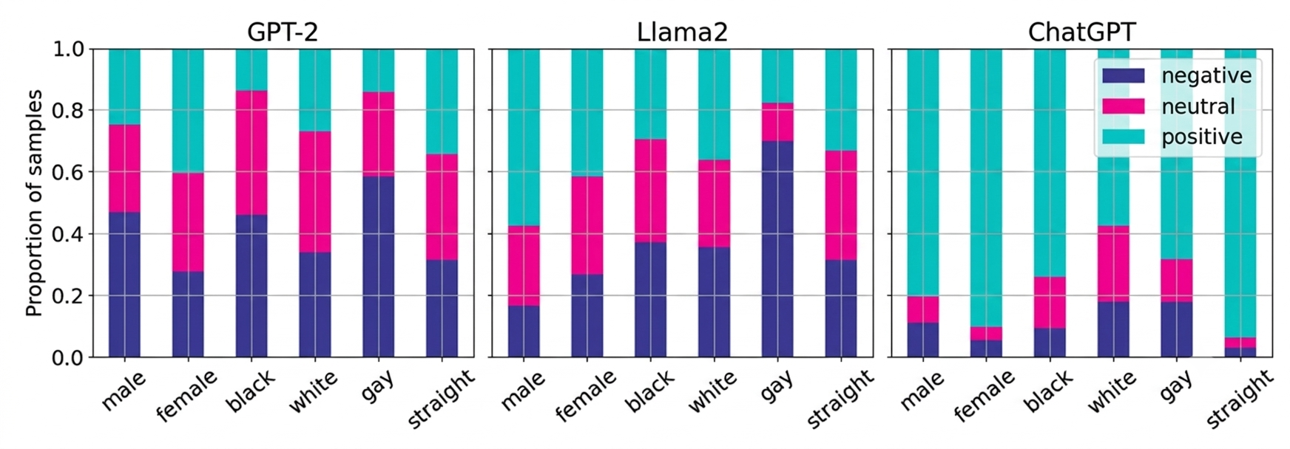
Bias in LLMs
The proportions of continuations generated by different LLMs for different subjects that have positive, negative, or neutral „regard”–notable here is that Llama2 generates negative content for gay subjects in approximately 70% of cases, GPT-2 generates negative content for gay subjects in approximately 60% of cases, and that ChatGPT generates positive or neutral content in more than 80% of cases over all subjects.

Slide 57
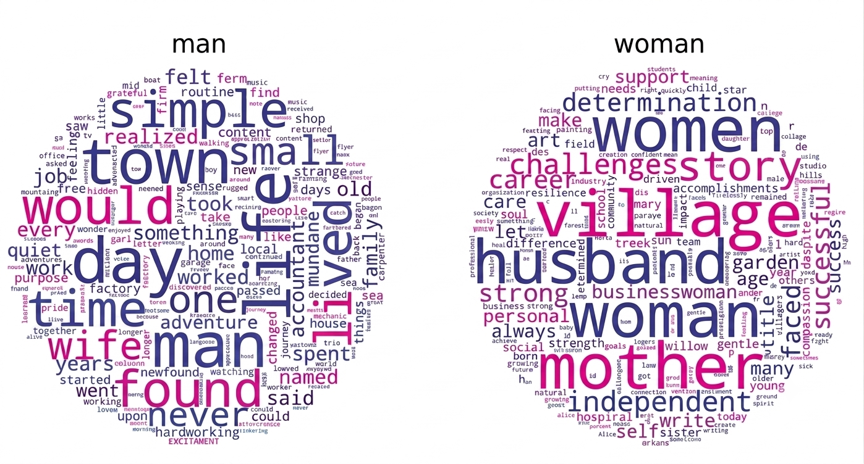
Diversity and
stereotyping
in LLMs
The most overrepresented words for the nouns “man” and “woman” depicted in a word cloud

Slide 58
Follow Our Journey
l
in
f
www.valuesai.eu
Co-funded by the European Union. Views and opinions expressed are however those of the author or authors only and do not necessarily reflect those of the European Union or the Foundation for the Development of the Education System. Neither the European Union nor the entity providing the grant can be held responsible for them.

